Slide 1
Optimizing Memory Layouts and Traversal Orders in HPC
Jiří Klepl
Department of Distributed and Dependable Systems
Notes:
Good morning,
Esteemed members of the committee, I’d like to present you my research.

Slide 2
Motivation
Simplify and streamline algorithm design for scientific computing
Regular data structures in nested loops
Optimizing memory accesses for best performance
Research Questions
Can developers specify memory access transformations via C++ abstractions without incurring runtime overhead?
Can developers write abstract computations and choose optimizations of value encoding and evaluation in specific domains?
How do design guidance and abstractions affect the performance and validity of LLM-generated code?
Notes:
(key idea: pitch the research in 30s)
My research focuses on simplifying and streamlining algorithm design for scientific computing.
Such algorithms typically operate on regular data structures in nested loops,
So one of the main challenges is optimizing its memory accesses to achieve the best performance.
To improve the algorithm design, we have designed native C++ layout and traversal abstractions
That offer a practical solution in parallel and distributed computing, we have then applied the same principles to specific domains to apply even broader optimizations, and explored algorithm optimizations guided by large language models.

Slide 3
Motivation
Simplify and streamline algorithm design for scientific computing
Regular data structures in nested loops
Optimizing memory accesses for best performance
Research Questions
Can developers specify memory access transformations via C++ abstractions without incurring runtime overhead?
Can developers write abstract computations and choose optimizations of value encoding and evaluation in specific domains?
How do design guidance and abstractions affect the performance and validity of LLM-generated code?
Notes:
(key idea: pitch the research in 30s)
My research focuses on simplifying and streamlining algorithm design for scientific computing.
Such algorithms typically operate on regular data structures in nested loops,
So one of the main challenges is optimizing its memory accesses to achieve the best performance.
To improve the algorithm design, we have designed native C++ layout and traversal abstractions
That offer a practical solution in parallel and distributed computing, we have then applied the same principles to specific domains to apply even broader optimizations, and explored algorithm optimizations guided by large language models.

Slide 4
Motivation
Simplify and streamline algorithm design for scientific computing
Regular data structures in nested loops
Optimizing memory accesses for best performance
Research Questions
Can developers specify memory access transformations via C++ abstractions without incurring runtime overhead?
Can developers write abstract computations and choose optimizations of value encoding and evaluation in specific domains?
How do design guidance and abstractions affect the performance and validity of LLM-generated code?
Notes:
(key idea: pitch the research in 30s)
My research focuses on simplifying and streamlining algorithm design for scientific computing.
Such algorithms typically operate on regular data structures in nested loops,
So one of the main challenges is optimizing its memory accesses to achieve the best performance.
To improve the algorithm design, we have designed native C++ layout and traversal abstractions
That offer a practical solution in parallel and distributed computing, we have then applied the same principles to specific domains to apply even broader optimizations, and explored algorithm optimizations guided by large language models.

Slide 5
Motivation
Simplify and streamline algorithm design for scientific computing
Regular data structures in nested loops
Optimizing memory accesses for best performance
Research Questions
Can developers specify memory access transformations via C++ abstractions without incurring runtime overhead?
Can developers write abstract computations and choose optimizations of value encoding and evaluation in specific domains?
How do design guidance and abstractions affect the performance and validity of LLM-generated code?
Notes:
(key idea: pitch the research in 30s)
My research focuses on simplifying and streamlining algorithm design for scientific computing.
Such algorithms typically operate on regular data structures in nested loops,
So one of the main challenges is optimizing its memory accesses to achieve the best performance.
To improve the algorithm design, we have designed native C++ layout and traversal abstractions
That offer a practical solution in parallel and distributed computing, we have then applied the same principles to specific domains to apply even broader optimizations, and explored algorithm optimizations guided by large language models.

Slide 6
Motivation
Simplify and streamline algorithm design for scientific computing
Regular data structures in nested loops
Optimizing memory accesses for best performance
Research Questions
Can developers specify memory access transformations via C++ abstractions without incurring runtime overhead?
Can developers write abstract computations and choose optimizations of value encoding and evaluation in specific domains?
How do design guidance and abstractions affect the performance and validity of LLM-generated code?
Notes:
(key idea: pitch the research in 30s)
My research focuses on simplifying and streamlining algorithm design for scientific computing.
Such algorithms typically operate on regular data structures in nested loops,
So one of the main challenges is optimizing its memory accesses to achieve the best performance.
To improve the algorithm design, we have designed native C++ layout and traversal abstractions
That offer a practical solution in parallel and distributed computing, we have then applied the same principles to specific domains to apply even broader optimizations, and explored algorithm optimizations guided by large language models.

Slide 7
Motivation
Simplify and streamline algorithm design for scientific computing
Regular data structures in nested loops
Optimizing memory accesses for best performance
Research Questions
Can developers specify memory access transformations via C++ abstractions without incurring runtime overhead?
Can developers write abstract computations and choose optimizations of value encoding and evaluation in specific domains?
How do design guidance and abstractions affect the performance and validity of LLM-generated code?
Notes:
(key idea: pitch the research in 30s)
My research focuses on simplifying and streamlining algorithm design for scientific computing.
Such algorithms typically operate on regular data structures in nested loops,
So one of the main challenges is optimizing its memory accesses to achieve the best performance.
To improve the algorithm design, we have designed native C++ layout and traversal abstractions
That offer a practical solution in parallel and distributed computing, we have then applied the same principles to specific domains to apply even broader optimizations, and explored algorithm optimizations guided by large language models.

Slide 8
Motivation
Simplify and streamline algorithm design for scientific computing
Regular data structures in nested loops
Optimizing memory accesses for best performance
Research Questions
Can developers specify memory access transformations via C++ abstractions without incurring runtime overhead?
Can developers write abstract computations and choose optimizations of value encoding and evaluation in specific domains?
How do design guidance and abstractions affect the performance and validity of LLM-generated code?
Notes:
(key idea: pitch the research in 30s)
My research focuses on simplifying and streamlining algorithm design for scientific computing.
Such algorithms typically operate on regular data structures in nested loops,
So one of the main challenges is optimizing its memory accesses to achieve the best performance.
To improve the algorithm design, we have designed native C++ layout and traversal abstractions
That offer a practical solution in parallel and distributed computing, we have then applied the same principles to specific domains to apply even broader optimizations, and explored algorithm optimizations guided by large language models.

Slide 9
Motivation
Simplify and streamline algorithm design for scientific computing
Regular data structures in nested loops
Optimizing memory accesses for best performance
Research Questions
Can developers specify memory access transformations via C++ abstractions without incurring runtime overhead?
Can developers write abstract computations and choose optimizations of value encoding and evaluation in specific domains?
How do design guidance and abstractions affect the performance and validity of LLM-generated code?
Notes:
(key idea: pitch the research in 30s)
My research focuses on simplifying and streamlining algorithm design for scientific computing.
Such algorithms typically operate on regular data structures in nested loops,
So one of the main challenges is optimizing its memory accesses to achieve the best performance.
To improve the algorithm design, we have designed native C++ layout and traversal abstractions
That offer a practical solution in parallel and distributed computing, we have then applied the same principles to specific domains to apply even broader optimizations, and explored algorithm optimizations guided by large language models.

Slide 10

Memory access transformations
Decoupling layouts and traversals from the algorithm
Parallelization of traversals
Distributed computing
Decoupling value encoding and evaluation strategy
Design guidance and abstractions’ effect on LLM-generated code
Publications
Astute Approach to Handling Memory Layouts of Regular Data Structures. ICA3PP, 2022
Pure C++ Approach to Optimized Parallel Traversal of Regular Data Structures. PPoPP, 2024
Abstractions for C++ code optimizations in parallel high-performance applications. ParCo, 2024
Layout-Agnostic MPI Abstraction for Distributed Computing in Modern C++. EuroMPI, 2025

Slide 11
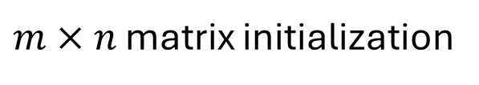
Why layouts matter
$m×n$ matrix initialization
for (int i = 0; i < M; i++)
for (int j = 0; j < N; j++)
matrix[i][j] = init(i, j);
Row-by-row traversal
Decoupling layouts and traversals
Notes:
(key idea: why choosing the “right” memory layout matters) Here, we initialize an m by n matrix row by row.
This is commonly expressed as an assignment nested in a two-dimensional loop nest; in this particular example, the indices are generated iteratively for the elements, row by row.
With the row-major layout, the inner loop advances along the columns within one row, so successive accesses are contiguous.
With the column-major layout, the same traversal accesses memory with a larger stride.
This affects hardware mechanisms such as caching, which makes accesses to close-by elements faster.

Slide 12
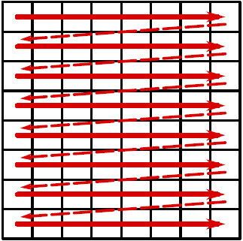


Why layouts matter
$m×n$ matrix initialization
for (int i = 0; i < M; i++)
for (int j = 0; j < N; j++)
matrix[i][j] = init(i, j);
Row-by-row traversal
$$n$$
$$m$$
🚀
Row-major
Decoupling layouts and traversals
Notes:
(key idea: why choosing the “right” memory layout matters) Here, we initialize an m by n matrix row by row.
This is commonly expressed as an assignment nested in a two-dimensional loop nest; in this particular example, the indices are generated iteratively for the elements, row by row.
With the row-major layout, the inner loop advances along the columns within one row, so successive accesses are contiguous.
With the column-major layout, the same traversal accesses memory with a larger stride.
This affects hardware mechanisms such as caching, which makes accesses to close-by elements faster.

Slide 13


Why layouts matter
$m×n$ matrix initialization
for (int i = 0; i < M; i++)
for (int j = 0; j < N; j++)
matrix[i][j] = init(i, j);
Row-by-row traversal
$$n$$
$$n$$
$$m$$
$$m$$
🚀
Row-major
Column-major
🐌
Decoupling layouts and traversals
Notes:
(key idea: why choosing the “right” memory layout matters) Here, we initialize an m by n matrix row by row.
This is commonly expressed as an assignment nested in a two-dimensional loop nest; in this particular example, the indices are generated iteratively for the elements, row by row.
With the row-major layout, the inner loop advances along the columns within one row, so successive accesses are contiguous.
With the column-major layout, the same traversal accesses memory with a larger stride.
This affects hardware mechanisms such as caching, which makes accesses to close-by elements faster.

Slide 14
Layout-agnostic design
for (int i = 0; i < M; i++)
for (int j = 0; j < N; j++)
matrix[i][j] = init(i, j);
Decoupling layouts and traversals
Notes:
(key idea: layout-agnostic design and layout abstractions)
As the correct choices in real-world algorithms with more complex data structures and traversals may not be so obvious,
we focused on *layout-agnostic* design of algorithms, which minimizes reliance on specific memory layouts of the data structures.
Using the same example, it accesses the matrix using the two-dimensional *index space*, while the specific *physical memory layout* is decoupled from the algorithm design.
The mapping from the index space to a physical memory layout forms a *layout abstraction*, commonly expressed as a linear function of the indices.

Slide 15


Layout-agnostic design
for (int i = 0; i < M; i++)
for (int j = 0; j < N; j++)
matrix[i][j] = init(i, j);
Index space
1
2
3
4
$$m$$
5
6
7
8
9
10
11
12
$$n$$
Decoupling layouts and traversals
Notes:
(key idea: layout-agnostic design and layout abstractions)
As the correct choices in real-world algorithms with more complex data structures and traversals may not be so obvious,
we focused on *layout-agnostic* design of algorithms, which minimizes reliance on specific memory layouts of the data structures.
Using the same example, it accesses the matrix using the two-dimensional *index space*, while the specific *physical memory layout* is decoupled from the algorithm design.
The mapping from the index space to a physical memory layout forms a *layout abstraction*, commonly expressed as a linear function of the indices.

Slide 16

Layout-agnostic design
for (int i = 0; i < M; i++)
for (int j = 0; j < N; j++)
matrix[i][j] = init(i, j);
Physical memory layout
Index space
$$i⋅N+j$$
1
2
3
4
5
6
7
8
9
10
11
12
1
2
3
4
$$m$$
Row-major
5
6
7
8
9
10
11
12
$$n$$
Decoupling layouts and traversals
Notes:
(key idea: layout-agnostic design and layout abstractions)
As the correct choices in real-world algorithms with more complex data structures and traversals may not be so obvious,
we focused on *layout-agnostic* design of algorithms, which minimizes reliance on specific memory layouts of the data structures.
Using the same example, it accesses the matrix using the two-dimensional *index space*, while the specific *physical memory layout* is decoupled from the algorithm design.
The mapping from the index space to a physical memory layout forms a *layout abstraction*, commonly expressed as a linear function of the indices.

Slide 17

Layout-agnostic design
for (int i = 0; i < M; i++)
for (int j = 0; j < N; j++)
matrix[i][j] = init(i, j);
Physical memory layout
Index space
$$i⋅N+j$$
1
2
3
4
5
6
7
8
9
10
11
12
1
2
3
4
$$m$$
Row-major
5
6
7
8
9
10
11
12
Another possible layout
$$n$$
$$j⋅M+i$$
1
5
9
2
6
10
3
7
11
4
8
12
Column-major
Decoupling layouts and traversals
Notes:
(key idea: layout-agnostic design and layout abstractions)
As the correct choices in real-world algorithms with more complex data structures and traversals may not be so obvious,
we focused on *layout-agnostic* design of algorithms, which minimizes reliance on specific memory layouts of the data structures.
Using the same example, it accesses the matrix using the two-dimensional *index space*, while the specific *physical memory layout* is decoupled from the algorithm design.
The mapping from the index space to a physical memory layout forms a *layout abstraction*, commonly expressed as a linear function of the indices.

Slide 18
Layout-agnostic design
for (int i = 0; i < M; i++)
for (int j = 0; j < N; j++)
matrix[i][j] = init(i, j);
Physical memory layout
Index space
$$i⋅N+j$$
1
2
3
4
5
6
7
8
9
10
11
12
1
2
3
4
$$m$$
Row-major
5
6
7
8
9
10
11
12
Another possible layout
$$n$$
$$j⋅M+i$$
1
5
9
2
6
10
3
7
11
4
8
12
Layout abstraction of a data structure
Column-major
Decoupling layouts and traversals
Notes:
(key idea: layout-agnostic design and layout abstractions)
As the correct choices in real-world algorithms with more complex data structures and traversals may not be so obvious,
we focused on *layout-agnostic* design of algorithms, which minimizes reliance on specific memory layouts of the data structures.
Using the same example, it accesses the matrix using the two-dimensional *index space*, while the specific *physical memory layout* is decoupled from the algorithm design.
The mapping from the index space to a physical memory layout forms a *layout abstraction*, commonly expressed as a linear function of the indices.

Slide 19
Layout abstractions (Noarr)
Composition of building blocks in native C++
layout = scalar <float> () ^
vector <'n'> (N) ^
vector <'m'> (M);
Decoupling layouts and traversals
Notes:
(key idea: key concepts of Noarr Structures)
We have implemented a native C++ abstraction using templates to ensure portability and minimal runtime overhead with no need for custom tooling.
It is based on composable *building blocks*, such as *scalar*, which names a single value, or *vector*, which extends the given layout with one named dimension.
A data structure with dimensions m and n can be indexed with an index point with the appropriate dimensions.
The encoded dimension names ensure that the indices are correctly paired with dimensions.
(The abstraction also enables encoding a known parameter in the type instead of the object, which the compiler may use in computations to achieve better optimization.)
---
A data structure can be constructed from a given layout using a simple *bag* constructor, which automatically manages an appropriate memory buffer.
If we require the data to reside in a specific buffer, we can supply it ourselves to create a non-owning view to the data.
---
(bridge)
Related forms of layout abstraction appear in std::mdspan and Kokkos::View, with limited composability and composable CuTe layouts for tensor representation in GPU programming. The indexation of these abstractions is based on linear algebra and uses positional encoding for the index space. The compositionality of our approach is not limited to linear algebra and generalizes well to traversal abstractions.

Slide 20
Layout abstractions (Noarr)
Composition of building blocks in native C++
Parameters specifying types and dimension names
layout = scalar <float> () ^
vector <'n'> (N) ^
vector <'m'> (M);
Decoupling layouts and traversals
Notes:
(key idea: key concepts of Noarr Structures)
We have implemented a native C++ abstraction using templates to ensure portability and minimal runtime overhead with no need for custom tooling.
It is based on composable *building blocks*, such as *scalar*, which names a single value, or *vector*, which extends the given layout with one named dimension.
A data structure with dimensions m and n can be indexed with an index point with the appropriate dimensions.
The encoded dimension names ensure that the indices are correctly paired with dimensions.
(The abstraction also enables encoding a known parameter in the type instead of the object, which the compiler may use in computations to achieve better optimization.)
---
A data structure can be constructed from a given layout using a simple *bag* constructor, which automatically manages an appropriate memory buffer.
If we require the data to reside in a specific buffer, we can supply it ourselves to create a non-owning view to the data.
---
(bridge)
Related forms of layout abstraction appear in std::mdspan and Kokkos::View, with limited composability and composable CuTe layouts for tensor representation in GPU programming. The indexation of these abstractions is based on linear algebra and uses positional encoding for the index space. The compositionality of our approach is not limited to linear algebra and generalizes well to traversal abstractions.

Slide 21

Layout abstractions (Noarr)
Composition of building blocks in native C++
Parameters specifying types and dimension names
$$n$$
layout = scalar <float> () ^
vector <'n'> (N) ^
vector <'m'> (M);
Decoupling layouts and traversals
Notes:
(key idea: key concepts of Noarr Structures)
We have implemented a native C++ abstraction using templates to ensure portability and minimal runtime overhead with no need for custom tooling.
It is based on composable *building blocks*, such as *scalar*, which names a single value, or *vector*, which extends the given layout with one named dimension.
A data structure with dimensions m and n can be indexed with an index point with the appropriate dimensions.
The encoded dimension names ensure that the indices are correctly paired with dimensions.
(The abstraction also enables encoding a known parameter in the type instead of the object, which the compiler may use in computations to achieve better optimization.)
---
A data structure can be constructed from a given layout using a simple *bag* constructor, which automatically manages an appropriate memory buffer.
If we require the data to reside in a specific buffer, we can supply it ourselves to create a non-owning view to the data.
---
(bridge)
Related forms of layout abstraction appear in std::mdspan and Kokkos::View, with limited composability and composable CuTe layouts for tensor representation in GPU programming. The indexation of these abstractions is based on linear algebra and uses positional encoding for the index space. The compositionality of our approach is not limited to linear algebra and generalizes well to traversal abstractions.

Slide 22

Layout abstractions (Noarr)
Composition of building blocks in native C++
Parameters specifying types and dimension names
$$n$$
layout = scalar <float> () ^
vector <'n'> (N) ^
vector <'m'> (M);
$$m$$
Decoupling layouts and traversals
Notes:
(key idea: key concepts of Noarr Structures)
We have implemented a native C++ abstraction using templates to ensure portability and minimal runtime overhead with no need for custom tooling.
It is based on composable *building blocks*, such as *scalar*, which names a single value, or *vector*, which extends the given layout with one named dimension.
A data structure with dimensions m and n can be indexed with an index point with the appropriate dimensions.
The encoded dimension names ensure that the indices are correctly paired with dimensions.
(The abstraction also enables encoding a known parameter in the type instead of the object, which the compiler may use in computations to achieve better optimization.)
---
A data structure can be constructed from a given layout using a simple *bag* constructor, which automatically manages an appropriate memory buffer.
If we require the data to reside in a specific buffer, we can supply it ourselves to create a non-owning view to the data.
---
(bridge)
Related forms of layout abstraction appear in std::mdspan and Kokkos::View, with limited composability and composable CuTe layouts for tensor representation in GPU programming. The indexation of these abstractions is based on linear algebra and uses positional encoding for the index space. The compositionality of our approach is not limited to linear algebra and generalizes well to traversal abstractions.

Slide 23
Layout abstractions (Noarr)
Composition of building blocks in native C++
Parameters specifying types and dimension names
$$n$$
layout = scalar <float> () ^
vector <'n'> (N) ^
vector <'m'> (M);
$$m$$
access
matrix[idx <'m','n'> (4,2)]
Decoupling layouts and traversals
Notes:
(key idea: key concepts of Noarr Structures)
We have implemented a native C++ abstraction using templates to ensure portability and minimal runtime overhead with no need for custom tooling.
It is based on composable *building blocks*, such as *scalar*, which names a single value, or *vector*, which extends the given layout with one named dimension.
A data structure with dimensions m and n can be indexed with an index point with the appropriate dimensions.
The encoded dimension names ensure that the indices are correctly paired with dimensions.
(The abstraction also enables encoding a known parameter in the type instead of the object, which the compiler may use in computations to achieve better optimization.)
---
A data structure can be constructed from a given layout using a simple *bag* constructor, which automatically manages an appropriate memory buffer.
If we require the data to reside in a specific buffer, we can supply it ourselves to create a non-owning view to the data.
---
(bridge)
Related forms of layout abstraction appear in std::mdspan and Kokkos::View, with limited composability and composable CuTe layouts for tensor representation in GPU programming. The indexation of these abstractions is based on linear algebra and uses positional encoding for the index space. The compositionality of our approach is not limited to linear algebra and generalizes well to traversal abstractions.

Slide 24
Layout abstractions (Noarr)
Composition of building blocks in native C++
Parameters specifying types and dimension names
$$n$$
layout = scalar <float> () ^
vector <'n'> (N) ^
vector <'m'> (M);
$$m$$
access
matrix[idx <'m','n'> (4,2)]
auto matrix = bag(layout);
Decoupling layouts and traversals
Notes:
(key idea: key concepts of Noarr Structures)
We have implemented a native C++ abstraction using templates to ensure portability and minimal runtime overhead with no need for custom tooling.
It is based on composable *building blocks*, such as *scalar*, which names a single value, or *vector*, which extends the given layout with one named dimension.
A data structure with dimensions m and n can be indexed with an index point with the appropriate dimensions.
The encoded dimension names ensure that the indices are correctly paired with dimensions.
(The abstraction also enables encoding a known parameter in the type instead of the object, which the compiler may use in computations to achieve better optimization.)
---
A data structure can be constructed from a given layout using a simple *bag* constructor, which automatically manages an appropriate memory buffer.
If we require the data to reside in a specific buffer, we can supply it ourselves to create a non-owning view to the data.
---
(bridge)
Related forms of layout abstraction appear in std::mdspan and Kokkos::View, with limited composability and composable CuTe layouts for tensor representation in GPU programming. The indexation of these abstractions is based on linear algebra and uses positional encoding for the index space. The compositionality of our approach is not limited to linear algebra and generalizes well to traversal abstractions.

Slide 25
Layout abstractions (Noarr)
Composition of building blocks in native C++
Parameters specifying types and dimension names
$$n$$
layout = scalar <float> () ^
vector <'n'> (N) ^
vector <'m'> (M);
$$m$$
access
matrix[idx <'m','n'> (4,2)]
GPU mem.
Mapped file
…
auto matrix = bag(layout);
auto matrix_view = bag(layout, myBuffer);
Decoupling layouts and traversals
Notes:
(key idea: key concepts of Noarr Structures)
We have implemented a native C++ abstraction using templates to ensure portability and minimal runtime overhead with no need for custom tooling.
It is based on composable *building blocks*, such as *scalar*, which names a single value, or *vector*, which extends the given layout with one named dimension.
A data structure with dimensions m and n can be indexed with an index point with the appropriate dimensions.
The encoded dimension names ensure that the indices are correctly paired with dimensions.
(The abstraction also enables encoding a known parameter in the type instead of the object, which the compiler may use in computations to achieve better optimization.)
---
A data structure can be constructed from a given layout using a simple *bag* constructor, which automatically manages an appropriate memory buffer.
If we require the data to reside in a specific buffer, we can supply it ourselves to create a non-owning view to the data.
---
(bridge)
Related forms of layout abstraction appear in std::mdspan and Kokkos::View, with limited composability and composable CuTe layouts for tensor representation in GPU programming. The indexation of these abstractions is based on linear algebra and uses positional encoding for the index space. The compositionality of our approach is not limited to linear algebra and generalizes well to traversal abstractions.

Slide 26
Traversal abstractions
Matrix initialization (not traversal-agnostic)
for (int i = 0; i < M; i++)
for (int j = 0; j < N; j++)
matrix[i][j] = init(i, j);
Decoupling layouts and traversals
Notes:
(key idea: introducing abstraction for traversal-agnostic algorithms – traversers) (with bridge: which enables traversal-agnostic design)
(without bridge: After carefully assessing how the principles play into defining layout-agnostic algorithms, we have extended the approach to define traversals as well, enabling traversal-agnostic design.)
For that, we have devised a traverser abstraction.
For a single structure, the traverser offers the functionality of a for-each algorithm – we can thus write the earlier shown initialization algorithm without relying on the dimensions of the structure.
The dimensions are traversed automatically and composed into an index point that is given as an argument to a lambda expression specifying the element-wise action on the traversed structure. If two structures share the same index space, a traverser constructed from them can be used to copy the data from one to the other. It automatically recognizes that their index spaces fully overlap and traverses all dimensions only once.
If the structures use different physical layouts, the same algorithm automatically converts between the memory layouts.
Generalizing this to a situation with different index spaces

Slide 27
Traversal abstractions
Matrix initialization (not traversal-agnostic)
for (int i = 0; i < M; i++)
for (int j = 0; j < N; j++)
matrix[i][j] = init(i, j);
idx <'m','n'> (…)
traverser(matrix).for_each([&](auto index) {
matrix[index] = init(index);
});
Traversal-agnostic Matrix initialization
Decoupling layouts and traversals
Notes:
(key idea: introducing abstraction for traversal-agnostic algorithms – traversers) (with bridge: which enables traversal-agnostic design)
(without bridge: After carefully assessing how the principles play into defining layout-agnostic algorithms, we have extended the approach to define traversals as well, enabling traversal-agnostic design.)
For that, we have devised a traverser abstraction.
For a single structure, the traverser offers the functionality of a for-each algorithm – we can thus write the earlier shown initialization algorithm without relying on the dimensions of the structure.
The dimensions are traversed automatically and composed into an index point that is given as an argument to a lambda expression specifying the element-wise action on the traversed structure. If two structures share the same index space, a traverser constructed from them can be used to copy the data from one to the other. It automatically recognizes that their index spaces fully overlap and traverses all dimensions only once.
If the structures use different physical layouts, the same algorithm automatically converts between the memory layouts.
Generalizing this to a situation with different index spaces

Slide 28
Traversal abstractions
Matrix initialization (not traversal-agnostic)
for (int i = 0; i < M; i++)
for (int j = 0; j < N; j++)
matrix[i][j] = init(i, j);
idx <'m','n'> (…)
traverser(matrix).for_each([&](auto index) {
matrix[index] = init(index);
});
Traversal-agnostic Matrix initialization
traverser(matrix, other_matrix).for_each([&](auto index) {
other_matrix[index] = matrix[index];
});
Copy to another matrix with the same index space
Decoupling layouts and traversals
Notes:
(key idea: introducing abstraction for traversal-agnostic algorithms – traversers) (with bridge: which enables traversal-agnostic design)
(without bridge: After carefully assessing how the principles play into defining layout-agnostic algorithms, we have extended the approach to define traversals as well, enabling traversal-agnostic design.)
For that, we have devised a traverser abstraction.
For a single structure, the traverser offers the functionality of a for-each algorithm – we can thus write the earlier shown initialization algorithm without relying on the dimensions of the structure.
The dimensions are traversed automatically and composed into an index point that is given as an argument to a lambda expression specifying the element-wise action on the traversed structure. If two structures share the same index space, a traverser constructed from them can be used to copy the data from one to the other. It automatically recognizes that their index spaces fully overlap and traverses all dimensions only once.
If the structures use different physical layouts, the same algorithm automatically converts between the memory layouts.
Generalizing this to a situation with different index spaces

Slide 29








Structures with different index spaces
Matrix multiplication
$$k$$
$$n$$
$$m$$
$$k$$
$$n$$
$$m$$
for (int i = 0; i < M; i++)
for (int j = 0; j < N; j++)
for (int k = 0; k < K; k++)
C[i][j] += A[i][k] * B[k][j];
$$⋅$$
$$=$$
A
B
C
Decoupling layouts and traversals
Notes:
(key idea: traversers – structures with non-overlapping index spaces)
This generalizes to structures with (partially or fully) independent index spaces.
Let’s show that on the matrix multiplication algorithm, which can be expressed as a three-dimensional loop nest.
We can define the same traversal by simply using the traverser on the three data structures.
It extracts the dimensions from the provided data structures and represents a loop nest from unique copies of the dimension.
(…)

Slide 30
Structures with different index spaces
Matrix multiplication
$$k$$
$$n$$
$$m$$
$$k$$
$$n$$
$$m$$
for (int i = 0; i < M; i++)
for (int j = 0; j < N; j++)
for (int k = 0; k < K; k++)
C[i][j] += A[i][k] * B[k][j];
$$⋅$$
$$=$$
A
B
C
traverser(A, B, C).for_each([&](auto index) {
C[index] += A[index] * B[index];
});
Decoupling layouts and traversals
Notes:
(key idea: traversers – structures with non-overlapping index spaces)
This generalizes to structures with (partially or fully) independent index spaces.
Let’s show that on the matrix multiplication algorithm, which can be expressed as a three-dimensional loop nest.
We can define the same traversal by simply using the traverser on the three data structures.
It extracts the dimensions from the provided data structures and represents a loop nest from unique copies of the dimension.
(…)

Slide 31

Structures with different index spaces
Matrix multiplication
$$k$$
$$n$$
$$m$$
$$k$$
$$n$$
$$m$$
for (int i = 0; i < M; i++)
for (int j = 0; j < N; j++)
for (int k = 0; k < K; k++)
C[i][j] += A[i][k] * B[k][j];
$$⋅$$
$$=$$
A
B
C
traverser(A, B, C).for_each([&](auto index) {
C[index] += A[index] * B[index];
});
A: $m× k$
B: $k × n$
C: $m×n$
Decoupling layouts and traversals
Notes:
(key idea: traversers – structures with non-overlapping index spaces)
This generalizes to structures with (partially or fully) independent index spaces.
Let’s show that on the matrix multiplication algorithm, which can be expressed as a three-dimensional loop nest.
We can define the same traversal by simply using the traverser on the three data structures.
It extracts the dimensions from the provided data structures and represents a loop nest from unique copies of the dimension.
(…)

Slide 32
Structures with different index spaces
Matrix multiplication
$$k$$
$$n$$
$$m$$
$$k$$
$$n$$
$$m$$
for (int i = 0; i < M; i++)
for (int j = 0; j < N; j++)
for (int k = 0; k < K; k++)
C[i][j] += A[i][k] * B[k][j];
$$⋅$$
$$=$$
A
B
C
traverser(A, B, C).for_each([&](auto index) {
C[index] += A[index] * B[index];
});
A: $m× k$
B: $k × n$
C: $m×n$
Decoupling layouts and traversals
Notes:
(key idea: traversers – structures with non-overlapping index spaces)
This generalizes to structures with (partially or fully) independent index spaces.
Let’s show that on the matrix multiplication algorithm, which can be expressed as a three-dimensional loop nest.
We can define the same traversal by simply using the traverser on the three data structures.
It extracts the dimensions from the provided data structures and represents a loop nest from unique copies of the dimension.
(…)

Slide 33

Structures with different index spaces
Matrix multiplication
$$k$$
$$n$$
$$m$$
$$k$$
$$n$$
$$m$$
for (int i = 0; i < M; i++)
for (int j = 0; j < N; j++)
for (int k = 0; k < K; k++)
C[i][j] += A[i][k] * B[k][j];
$$⋅$$
$$=$$
A
B
C
traverser(A, B, C).for_each([&](auto index) {
C[index] += A[index] * B[index];
});
A: $m× k$
B: $k × n$
C: $m×n$
Unique occurrences
$$m×n×k$$
Decoupling layouts and traversals
Notes:
(key idea: traversers – structures with non-overlapping index spaces)
This generalizes to structures with (partially or fully) independent index spaces.
Let’s show that on the matrix multiplication algorithm, which can be expressed as a three-dimensional loop nest.
We can define the same traversal by simply using the traverser on the three data structures.
It extracts the dimensions from the provided data structures and represents a loop nest from unique copies of the dimension.
(…)

Slide 34
Structures with different index spaces
Matrix multiplication
$$k$$
$$n$$
$$m$$
$$k$$
$$n$$
$$m$$
for (int i = 0; i < M; i++)
for (int j = 0; j < N; j++)
for (int k = 0; k < K; k++)
C[i][j] += A[i][k] * B[k][j];
$$⋅$$
$$=$$
A
B
C
traverser(A, B, C).for_each([&](auto index) {
C[index] += A[index] * B[index];
});
A: $m× k$
B: $k × n$
C: $m×n$
Unique occurrences
$$m×n×k$$
Decoupling layouts and traversals
Notes:
(key idea: traversers – structures with non-overlapping index spaces)
This generalizes to structures with (partially or fully) independent index spaces.
Let’s show that on the matrix multiplication algorithm, which can be expressed as a three-dimensional loop nest.
We can define the same traversal by simply using the traverser on the three data structures.
It extracts the dimensions from the provided data structures and represents a loop nest from unique copies of the dimension.
(…)

Slide 35
Structures with different index spaces
Matrix multiplication
$$k$$
$$n$$
$$m$$
$$k$$
$$n$$
$$m$$
for (int i = 0; i < M; i++)
for (int j = 0; j < N; j++)
for (int k = 0; k < K; k++)
C[i][j] += A[i][k] * B[k][j];
$$⋅$$
$$=$$
A
B
C
traverser(A, B, C).for_each([&](auto index) {
C[index] += A[index] * B[index];
});
Correct indices passed automatically
A: $m× k$
B: $k × n$
C: $m×n$
Unique occurrences
$$m×n×k$$
Decoupling layouts and traversals
Notes:
(key idea: traversers – structures with non-overlapping index spaces)
This generalizes to structures with (partially or fully) independent index spaces.
Let’s show that on the matrix multiplication algorithm, which can be expressed as a three-dimensional loop nest.
We can define the same traversal by simply using the traverser on the three data structures.
It extracts the dimensions from the provided data structures and represents a loop nest from unique copies of the dimension.
(…)

Slide 36








Same computation, different traversal
(traverser(C, B, A) ^ by_tiles).for_each([&](auto index) {
C[index] += A[index] * B[index];
});
traverser(A, B, C).for_each([&](auto index) {
C[index] += A[index] * B[index];
});
Common optimization: compute by tiles
$$k$$
$$n$$
$$m$$
$$k$$
$$n$$
$$m$$
$$⋅$$
$$=$$
A
B
C
Decoupling layouts and traversals
Notes:
(key idea: optimizing the traversal)
(…)
Let’s say we want to perform the matrix multiplication by tiles of the output to improve the caching behavior. We can define a transformation using the same principles as the layouts and then apply it to the traverser.
(…)

Slide 37
Same computation, different traversal
auto by_tiles = into_blocks <'m','M'> (16) ^
into_blocks <'n','N'> (16) ^
hoist <'M','N'> ();
(traverser(C, B, A) ^ by_tiles).for_each([&](auto index) {
C[index] += A[index] * B[index];
});
Common optimization: compute by tiles
$$k$$
$$n$$
$$m$$
$$k$$
$$n$$
$$m$$
$$⋅$$
$$=$$
A
B
C
Decoupling layouts and traversals
Notes:
(key idea: optimizing the traversal)
(…)
Let’s say we want to perform the matrix multiplication by tiles of the output to improve the caching behavior. We can define a transformation using the same principles as the layouts and then apply it to the traverser.
(…)

Slide 38
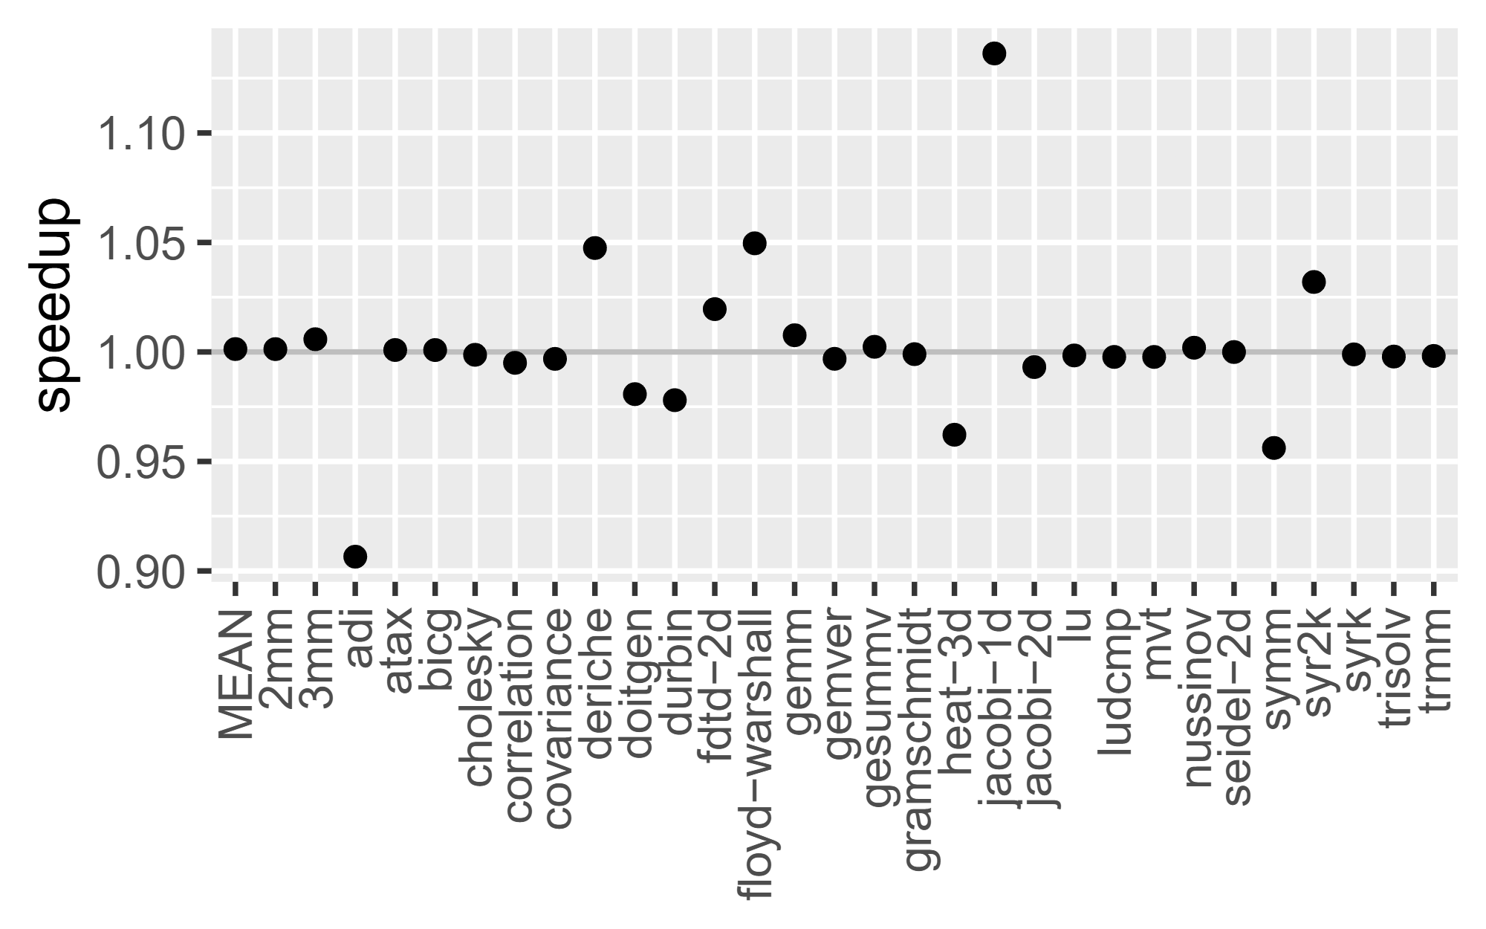
No measurable runtime overhead
PolyBench/C
Decoupling layouts and traversals
Notes:
(key idea: the abstractions pose no runtime overhead)
We have evaluated the abstractions on PolyBench/C, a standard HPC benchmark suite with algorithms from different areas, reimplementing each algorithm using Noarr and comparing them to the C baselines.
The plot shows the relative speedup, highlighting the difference in performance; most implementations perform on par, showing the abstraction does not introduce measurable runtime overhead.
(…)

Slide 39
Memory access transformations
Decoupling layouts and traversals from the algorithm
Parallelization of traversals
Distributed computing
Decoupling value encoding and evaluation strategy
Design guidance and abstractions’ effect on LLM-generated code
Publications
Astute Approach to Handling Memory Layouts of Regular Data Structures. ICA3PP, 2022
Pure C++ Approach to Optimized Parallel Traversal of Regular Data Structures. PPoPP, 2024
Abstractions for C++ code optimizations in parallel high-performance applications. ParCo, 2024
Layout-Agnostic MPI Abstraction for Distributed Computing in Modern C++. EuroMPI, 2025

Slide 40
Traversal parallelization
CPU
OpenMP
omp_for_each(traverser, …)
oneTBB
tbb_for_each(traverser, …)
GPU
cuda_traverser = cuda_threads <'t','b'> (traverser)
cuda_traverser.simple_run(…)
Parallelization of traversals
Notes:
(key idea: parallelizing the traversal)
(…)
We can also parallelize the computation on CPU using various parallel backends such as OpenMP or Threading Building Blocks using dedicated for_each executors.
For parallelization using the CUDA framework, we define cuda_traversers, which bind the traversal to the GPU and then run the computation in many threads.

Slide 41
Traversal parallelization
CPU
OpenMP
omp_for_each(traverser, …)
oneTBB
tbb_for_each(traverser, …)
GPU
cuda_traverser = cuda_threads <'t','b'> (traverser)
cuda_traverser.simple_run(…)
Parallelization of traversals
Notes:
(key idea: parallelizing the traversal)
(…)
We can also parallelize the computation on CPU using various parallel backends such as OpenMP or Threading Building Blocks using dedicated for_each executors.
For parallelization using the CUDA framework, we define cuda_traversers, which bind the traversal to the GPU and then run the computation in many threads.

Slide 42
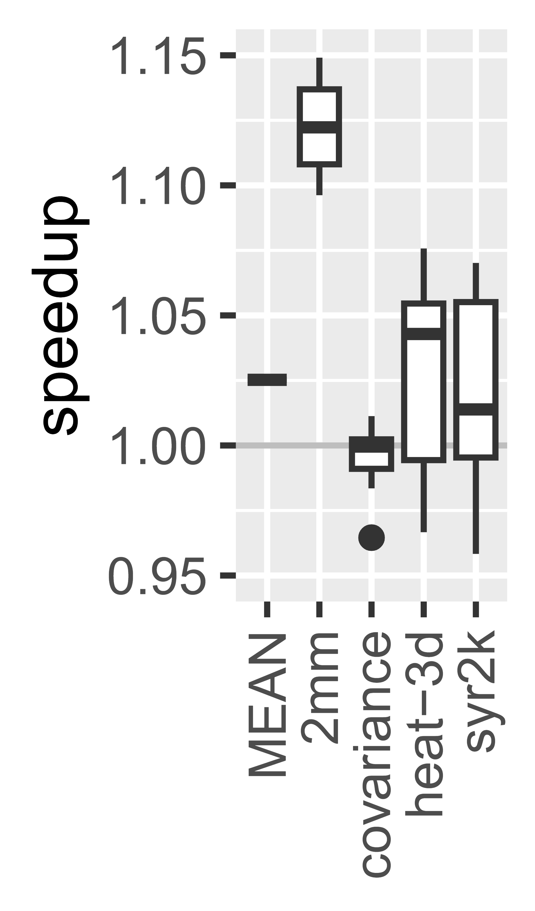
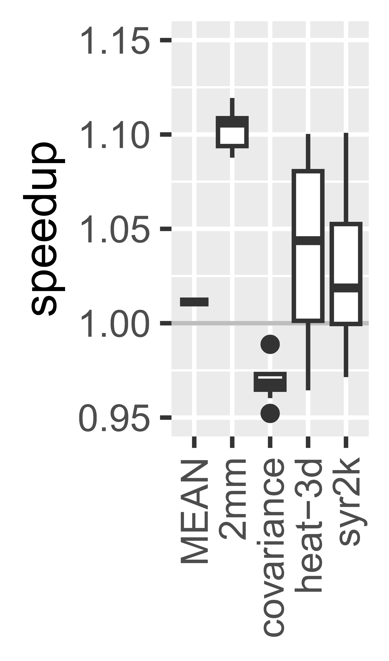
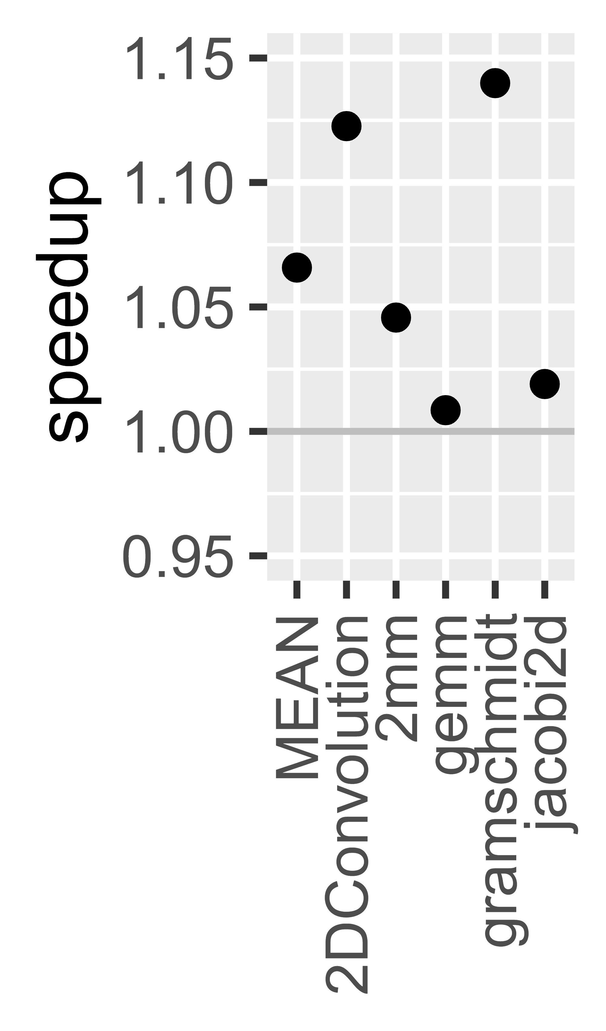
No overhead in parallelization
PolyBench/C
PolyBench/GPU
OpenMP
TBB
CUDA
Parallelization of traversals
Notes:
(key idea: the abstractions pose no runtime overhead)
(…)
For parallelization, we reimplemented OpenMP- and TBB-parallelized modifications of some algorithms, as well as the PolyBench/GPU suite, and obtained similar results.

Slide 43
Memory access transformations
Decoupling layouts and traversals from the algorithm
Parallelization of traversals
Distributed computing
Decoupling value encoding and evaluation strategy
Design guidance and abstractions’ effect on LLM-generated code
Publications
Astute Approach to Handling Memory Layouts of Regular Data Structures. ICA3PP, 2022
Pure C++ Approach to Optimized Parallel Traversal of Regular Data Structures. PPoPP, 2024
Abstractions for C++ code optimizations in parallel high-performance applications. ParCo, 2024
Layout-Agnostic MPI Abstraction for Distributed Computing in Modern C++. EuroMPI, 2025

Slide 44


Distributed initialization using MPI
We want to distribute:
traverser(matrix).for_each([&](auto index) {
matrix[index] = init(index);
});
$$n$$
MPI processes
$M$ blocks of $m$
Data
Distributed computing
Notes:
(key idea: distributed computing can benefit from layout-agnostic design)
We have shown that the abstractions can be practical for local, parallel algorithms, but many scientific computing algorithms run in a distributed manner on clusters with many computation nodes, which further complicates the design of applications.
We have thus investigated how the principles from the abstractions work in the context of distributed computing;
Specifically, using MPI, which is the most predominant technology used to distribute general computing tasks in C++.
Many work distribution patterns, including data communication, can be described using the building blocks for layouts and traversals.
So, let’s reuse the initialization algorithm and distribute it, initializing each tile of the data in a separate MPI process and then gathering the tiles into fully initialized data.
Binding a traversal dimension to the participating MPI ranks described by an MPI communicator.
For the binding, we implemented an MPI traverser that binds the communicator to a specified dimension.
This then allows us to define the derived local tile and instantiate it similarly to the serial implementation.

Slide 45
Distributed initialization using MPI
We want to distribute:
traverser(matrix).for_each([&](auto index) {
matrix[index] = init(index);
});
$$n$$
Binding traversal to an MPI communicator
MPI processes
$M$ blocks of $m$
Data
Distributed computing
Notes:
(key idea: distributed computing can benefit from layout-agnostic design)
We have shown that the abstractions can be practical for local, parallel algorithms, but many scientific computing algorithms run in a distributed manner on clusters with many computation nodes, which further complicates the design of applications.
We have thus investigated how the principles from the abstractions work in the context of distributed computing;
Specifically, using MPI, which is the most predominant technology used to distribute general computing tasks in C++.
Many work distribution patterns, including data communication, can be described using the building blocks for layouts and traversals.
So, let’s reuse the initialization algorithm and distribute it, initializing each tile of the data in a separate MPI process and then gathering the tiles into fully initialized data.
Binding a traversal dimension to the participating MPI ranks described by an MPI communicator.
For the binding, we implemented an MPI traverser that binds the communicator to a specified dimension.
This then allows us to define the derived local tile and instantiate it similarly to the serial implementation.

Slide 46
Distributed initialization using MPI
We want to distribute:
traverser(matrix).for_each([&](auto index) {
matrix[index] = init(index);
});
$$n$$
Binding traversal to an MPI communicator
auto MPItrav =
mpi_traverser <'M'> (traverser, MPI_COMM_WORLD);
auto Tile = …
MPItrav.for_each([&](auto index) {
Tile[index] = init(index);
});
gather(Tile, Data, root, MPItrav);
MPI processes
$M$ blocks of $m$
Data
Distributed computing
Notes:
(key idea: distributed computing can benefit from layout-agnostic design)
We have shown that the abstractions can be practical for local, parallel algorithms, but many scientific computing algorithms run in a distributed manner on clusters with many computation nodes, which further complicates the design of applications.
We have thus investigated how the principles from the abstractions work in the context of distributed computing;
Specifically, using MPI, which is the most predominant technology used to distribute general computing tasks in C++.
Many work distribution patterns, including data communication, can be described using the building blocks for layouts and traversals.
So, let’s reuse the initialization algorithm and distribute it, initializing each tile of the data in a separate MPI process and then gathering the tiles into fully initialized data.
Binding a traversal dimension to the participating MPI ranks described by an MPI communicator.
For the binding, we implemented an MPI traverser that binds the communicator to a specified dimension.
This then allows us to define the derived local tile and instantiate it similarly to the serial implementation.

Slide 47
Distributed initialization using MPI
We want to distribute:
traverser(matrix).for_each([&](auto index) {
matrix[index] = init(index);
});
$$n$$
Binding traversal to an MPI communicator
auto MPItrav =
mpi_traverser <'M'> (traverser, MPI_COMM_WORLD);
auto Tile = …
MPItrav.for_each([&](auto index) {
Tile[index] = init(index);
});
gather(Tile, Data, root, MPItrav);
MPI processes
$M$ blocks of $m$
Data
Distributed computing
Notes:
(key idea: distributed computing can benefit from layout-agnostic design)
We have shown that the abstractions can be practical for local, parallel algorithms, but many scientific computing algorithms run in a distributed manner on clusters with many computation nodes, which further complicates the design of applications.
We have thus investigated how the principles from the abstractions work in the context of distributed computing;
Specifically, using MPI, which is the most predominant technology used to distribute general computing tasks in C++.
Many work distribution patterns, including data communication, can be described using the building blocks for layouts and traversals.
So, let’s reuse the initialization algorithm and distribute it, initializing each tile of the data in a separate MPI process and then gathering the tiles into fully initialized data.
Binding a traversal dimension to the participating MPI ranks described by an MPI communicator.
For the binding, we implemented an MPI traverser that binds the communicator to a specified dimension.
This then allows us to define the derived local tile and instantiate it similarly to the serial implementation.

Slide 48
Distributed initialization using MPI
We want to distribute:
traverser(matrix).for_each([&](auto index) {
matrix[index] = init(index);
});
$$n$$
Binding traversal to an MPI communicator
auto MPItrav =
mpi_traverser <'M'> (traverser, MPI_COMM_WORLD);
auto Tile = …
MPItrav.for_each([&](auto index) {
Tile[index] = init(index);
});
gather(Tile, Data, root, MPItrav);
MPI processes
$M$ blocks of $m$
Data
Distributed computing
Notes:
(key idea: distributed computing can benefit from layout-agnostic design)
We have shown that the abstractions can be practical for local, parallel algorithms, but many scientific computing algorithms run in a distributed manner on clusters with many computation nodes, which further complicates the design of applications.
We have thus investigated how the principles from the abstractions work in the context of distributed computing;
Specifically, using MPI, which is the most predominant technology used to distribute general computing tasks in C++.
Many work distribution patterns, including data communication, can be described using the building blocks for layouts and traversals.
So, let’s reuse the initialization algorithm and distribute it, initializing each tile of the data in a separate MPI process and then gathering the tiles into fully initialized data.
Binding a traversal dimension to the participating MPI ranks described by an MPI communicator.
For the binding, we implemented an MPI traverser that binds the communicator to a specified dimension.
This then allows us to define the derived local tile and instantiate it similarly to the serial implementation.

Slide 49
Automatic transformation in communication
send(row_major);
1
2
3
4
5
6
7
8
naive
recv(col_major);
9
10
11
12
1
2
3
4
5
6
physical layout
7
8
9
10
11
12
Distributed computing
Notes:
(key idea: why)
If the type translation worked naïvely by following the physical layout, the logical ordering of the data could be lost.
Our approach follows the logical ordering of the elements based on the index space and sends them correctly.
This, of course, works in collective operations, such as scatter and gather, as well.

Slide 50
Automatic transformation in communication
send(row_major);
1
2
3
4
5
6
7
8
naive
ours
recv(col_major);
9
10
11
12
recv(col_major);
1
2
3
1
5
9
4
5
6
physical layout
2
6
10
logical ordering
7
8
9
3
7
11
10
11
12
4
8
12
Distributed computing
Notes:
(key idea: why)
If the type translation worked naïvely by following the physical layout, the logical ordering of the data could be lost.
Our approach follows the logical ordering of the elements based on the index space and sends them correctly.
This, of course, works in collective operations, such as scatter and gather, as well.

Slide 51
Automatic transformation in communication
send(row_major);
Same for bcast, scatter, gather, …
1
2
3
4
5
6
7
8
naive
ours
recv(col_major);
9
10
11
12
recv(col_major);
1
2
3
1
5
9
4
5
6
physical layout
2
6
10
logical ordering
7
8
9
3
7
11
10
11
12
4
8
12
Distributed computing
Notes:
(key idea: why)
If the type translation worked naïvely by following the physical layout, the logical ordering of the data could be lost.
Our approach follows the logical ordering of the elements based on the index space and sends them correctly.
This, of course, works in collective operations, such as scatter and gather, as well.

Slide 52
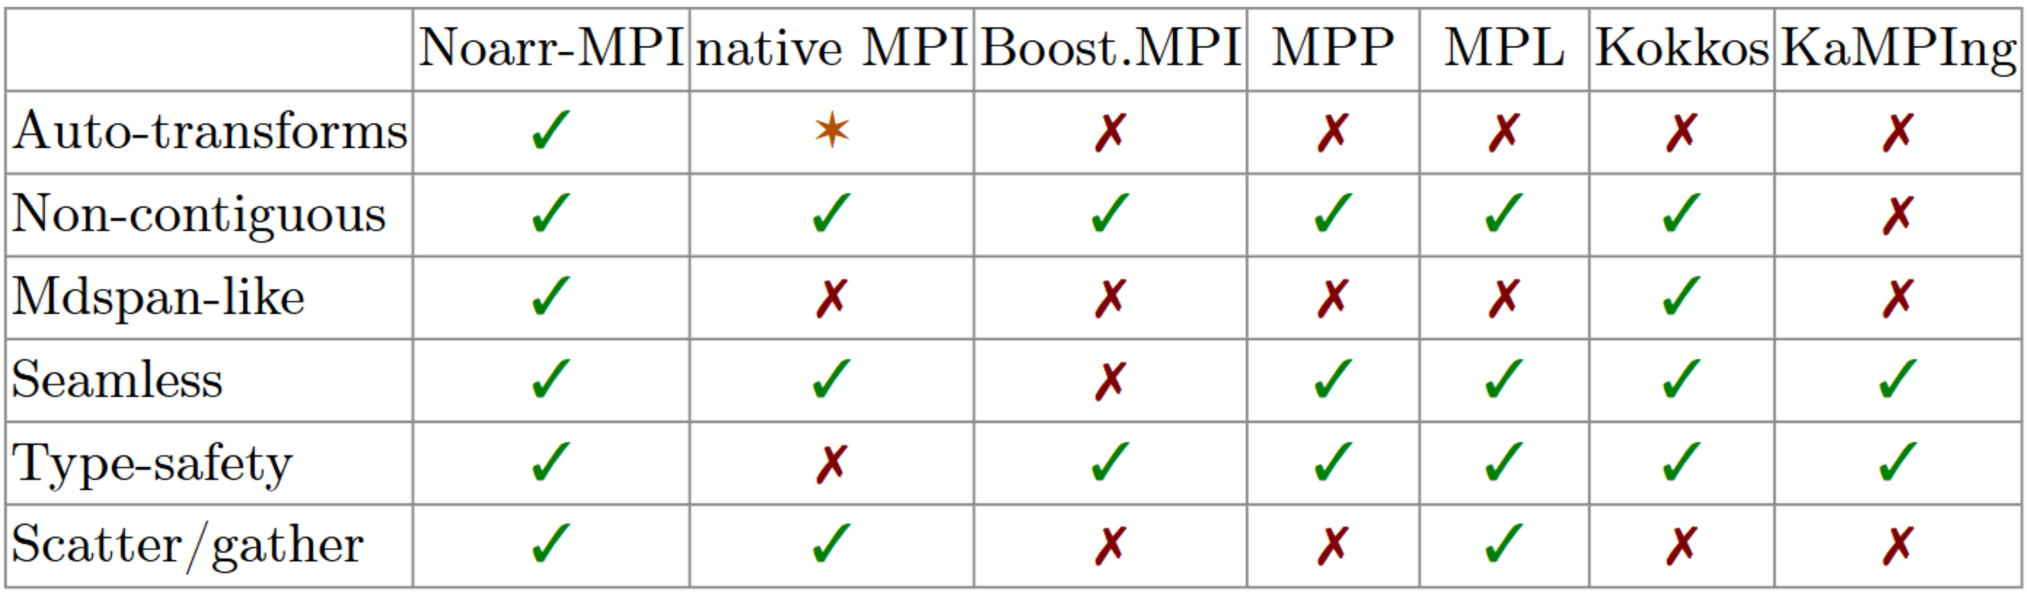
Support for layout-agnostic data distribution
Distributed computing
Notes:
(key idea: it is very great)
We have compared our approach with various state-of-the-art C++ MPI bindings in terms of how they support layout-agnostic data distribution. For that, we have identified 6 main characteristics.
Our approach is the only one that automatically handles differing physical layouts of multidimensional data on opposite endpoints of communication,
checks type safety and supports collective operations such as scatter and gather.
(…)

Slide 53
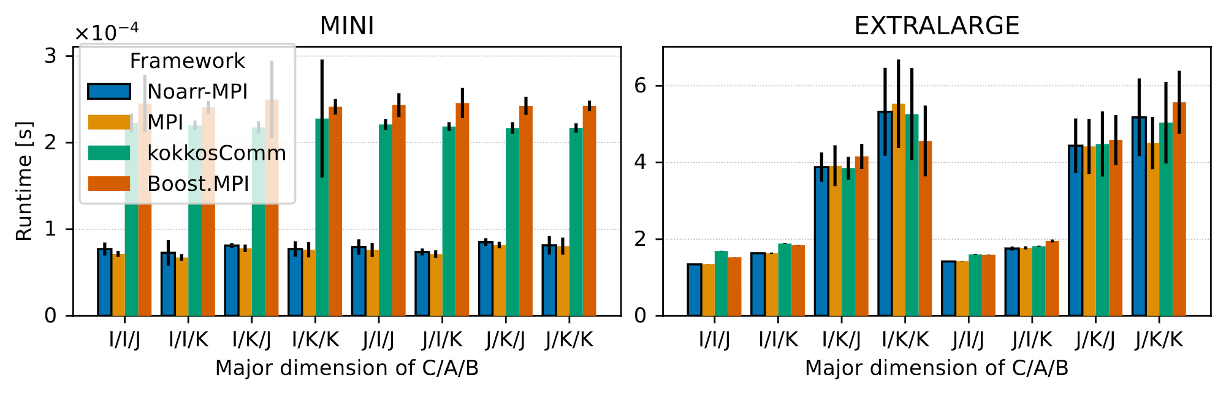
Noarr-MPI does not introduce overhead
Distributed computing
Notes:
(key idea: it is very great)
(…)
In terms of performance, our approach does not add a significant overhead compared to a hand-written native MPI distributed computation.
Here we show the runtime of an application using various bindings; lower is better.
The plot on the left shows the computation on small data of various layouts, highlighting the possible performance overhead introduced by the MPI bindings, while the one on the right highlights possible performance differences between different choices of layouts.
In both plots, our approach performs on par with the hand-written implementation.

Slide 54
Memory access transformations
Decoupling value encoding and evaluation strategy
Design guidance and abstractions’ effect on LLM-generated code
Publications
Cellato: a DSL for Cellular Automata based on Template Metaprogramming. JOT, 2026
Improving Cellular Automata Performance. ParCo, 2026 (submitted)

Slide 55
Stencil computation abstractions
Example of an 8-point stencil
Updated cell
Neighborhood
Decoupling value encoding and evaluation strategy
Notes:
(key idea: knowledge transfer to stencil computation)
Covering the major aspects of general-purpose HPC programming, we studied the application of the principles to more specific domains.
One domain from our past research where we could expand on the abstractions was stencil computations.
Stencil computations are used in many fields, for example, weather prediction and image processing.
They are computed on regular grids with cells.
And the grid is updated by applying a neighborhood-based rule to each cell.
While the earlier abstractions are usable for defining and optimizing general stencil computations, we have studied whether we can abstract away even more details of the implementation.
(…)

Slide 56
Stencil computation abstractions
Example of an 8-point stencil
Updated cell
Neighborhood
Physics simulation
Image processing
Decoupling value encoding and evaluation strategy
Notes:
(key idea: knowledge transfer to stencil computation)
Covering the major aspects of general-purpose HPC programming, we studied the application of the principles to more specific domains.
One domain from our past research where we could expand on the abstractions was stencil computations.
Stencil computations are used in many fields, for example, weather prediction and image processing.
They are computed on regular grids with cells.
And the grid is updated by applying a neighborhood-based rule to each cell.
While the earlier abstractions are usable for defining and optimizing general stencil computations, we have studied whether we can abstract away even more details of the implementation.
(…)

Slide 57

Stencil computation abstractions
Example of an 8-point stencil
Can we abstract more?
Updated cell
Collegue Brabec
Neighborhood
Physics simulation
Image processing
Decoupling value encoding and evaluation strategy
Notes:
(key idea: knowledge transfer to stencil computation)
Covering the major aspects of general-purpose HPC programming, we studied the application of the principles to more specific domains.
One domain from our past research where we could expand on the abstractions was stencil computations.
Stencil computations are used in many fields, for example, weather prediction and image processing.
They are computed on regular grids with cells.
And the grid is updated by applying a neighborhood-based rule to each cell.
While the earlier abstractions are usable for defining and optimizing general stencil computations, we have studied whether we can abstract away even more details of the implementation.
(…)

Slide 58

Discrete stencils – Cellular automata
Decoupling value encoding and evaluation strategy
Notes:
(key idea: cellular automata)
We have successfully designed such abstractions for a specific subclass of stencil computations with discrete cell states – Cellular automata.
They are used for modeling various systems, such as fluid dynamics or materials science.
Their rules can be expressed as nested logic expressions that depend on cell states in the neighborhood.
We developed an abstraction that allows the rule to be encoded in a type-level expression that does not assume any specific layout, traversal, or even cell state encoding and evaluation strategy.
(…)

Slide 59
Discrete stencils – Cellular automata
Discrete state space
Neighbor-count rules
Decoupling value encoding and evaluation strategy
Notes:
(key idea: cellular automata)
We have successfully designed such abstractions for a specific subclass of stencil computations with discrete cell states – Cellular automata.
They are used for modeling various systems, such as fluid dynamics or materials science.
Their rules can be expressed as nested logic expressions that depend on cell states in the neighborhood.
We developed an abstraction that allows the rule to be encoded in a type-level expression that does not assume any specific layout, traversal, or even cell state encoding and evaluation strategy.
(…)

Slide 60
Discrete stencils – Cellular automata
Discrete state space
Neighbor-count rules
Update rule for Game of Life
if (current = = ALIVE) {
if (neighbors = = 3 || neighbors = = 2)
next = ALIVE;
else
next = DEAD;
} else if (neighbors = = 3)
next = ALIVE;
else
next = DEAD;
Decoupling value encoding and evaluation strategy
Notes:
(key idea: cellular automata)
We have successfully designed such abstractions for a specific subclass of stencil computations with discrete cell states – Cellular automata.
They are used for modeling various systems, such as fluid dynamics or materials science.
Their rules can be expressed as nested logic expressions that depend on cell states in the neighborhood.
We developed an abstraction that allows the rule to be encoded in a type-level expression that does not assume any specific layout, traversal, or even cell state encoding and evaluation strategy.
(…)

Slide 61
Discrete stencils – Cellular automata
Discrete state space
Neighbor-count rules
Update rule for Game of Life
if (current = = ALIVE) {
if (neighbors = = 3 || neighbors = = 2)
next = ALIVE;
else
next = DEAD;
} else if (neighbors = = 3)
next = ALIVE;
else
next = DEAD;
Type-level expression (Cellato DSL)
if_<is_alive>::then_<
if_<has3_or_2>::then_<alive>::else_<dead>
>::else_<
if_<has3>::then_<alive>::else_<dead>
>;
Decoupling value encoding and evaluation strategy
Notes:
(key idea: cellular automata)
We have successfully designed such abstractions for a specific subclass of stencil computations with discrete cell states – Cellular automata.
They are used for modeling various systems, such as fluid dynamics or materials science.
Their rules can be expressed as nested logic expressions that depend on cell states in the neighborhood.
We developed an abstraction that allows the rule to be encoded in a type-level expression that does not assume any specific layout, traversal, or even cell state encoding and evaluation strategy.
(…)

Slide 62
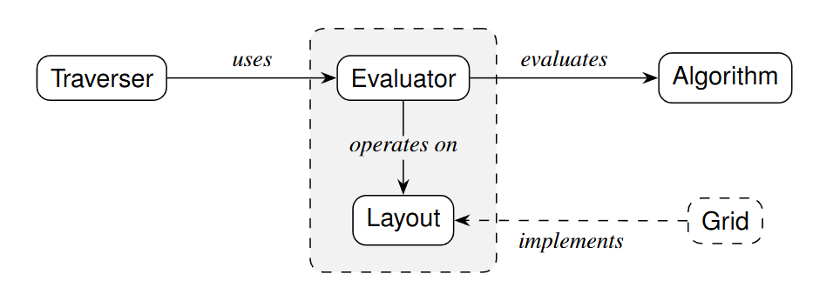
Type-level expression (Cellato DSL)
if_<is_alive>::then_<
if_<has3_or_2>::then_<alive>::else_<dead>
>::else_<
if_<has3>::then_<alive>::else_<dead>
>;
Already prepared in the library
Decoupling value encoding and evaluation strategy
Notes:
(…; there is some template metaprogramming magic that enables cool stuff)
This type-level expression can then be evaluated by applying specific templated components via metaprogramming; they specify
How the grid and the cells are encoded
How the update rules should be computed
Order of computation as well as the parallelization
This enables faster development and prototyping of the automata and simplifies experimental exploration of different optimization techniques.
(…)

Slide 63
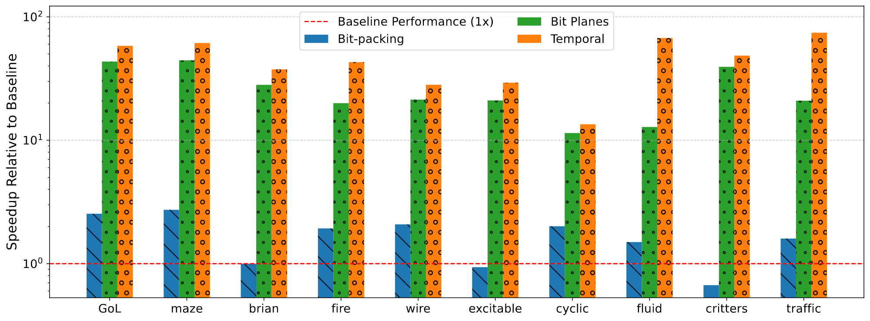
What the design allows us to gain
Comparison of GPU-parallelized computation of various cellular automata
Decoupling value encoding and evaluation strategy
Notes:
(…; it can be fast)
Here, we visualize possible speedup gains enabled by the applicable optimization strategies on multiple cellular automata.
The plot shows that for most of the automata, the right choice of (automatically applied) optimizations may lead to between one and two orders of magnitude over already GPU-parallelized solutions.

Slide 64
Memory access transformations
Decoupling value encoding and evaluation strategy
Design guidance and abstractions’ effect on LLM-generated code
Publications
Tutoring LLM into a Better CUDA Optimizer. Euro-Par, 2025
Abstractions and Prompting Strategies on LLM-Guided Optimization. ICA3PP, 2026

Slide 65

Tutoring LLMs for CUDA
Implement efficient algorithm
Not very good code
Design guidance and abstractions effect on LLM-generated code
Notes:
(key idea: tutoring; what is it?)
LLMs could implement simple algorithms but were not yet competent enough to make high-level design decisions for efficient computation, especially in parallel algorithms.
Therefore, our research has focused on identifying what helps LLMs generate better code and what does not.
In our first LLM study, we examined whether adding increasingly detailed high-level design hints or outright dictating main design decisions significantly improves the generated CUDA code compared to a naïve approach that simply requests an efficient implementation.
(…)

Slide 66
Tutoring LLMs for CUDA
Implement efficient algorithm
… Here are some hints
Follow this design
…
…
Not very good code
Better code
Efficient code?
Design guidance and abstractions effect on LLM-generated code
Notes:
(key idea: tutoring; what is it?)
LLMs could implement simple algorithms but were not yet competent enough to make high-level design decisions for efficient computation, especially in parallel algorithms.
Therefore, our research has focused on identifying what helps LLMs generate better code and what does not.
In our first LLM study, we examined whether adding increasingly detailed high-level design hints or outright dictating main design decisions significantly improves the generated CUDA code compared to a naïve approach that simply requests an efficient implementation.
(…)

Slide 67
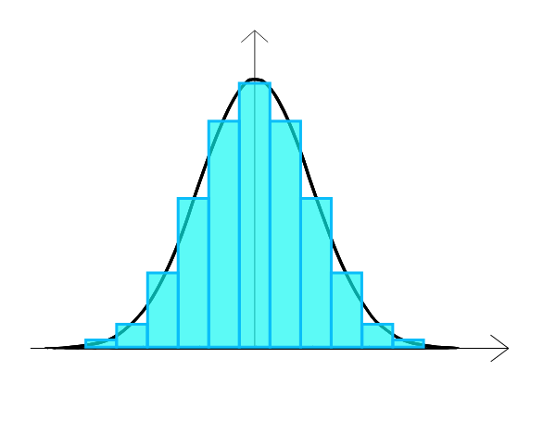
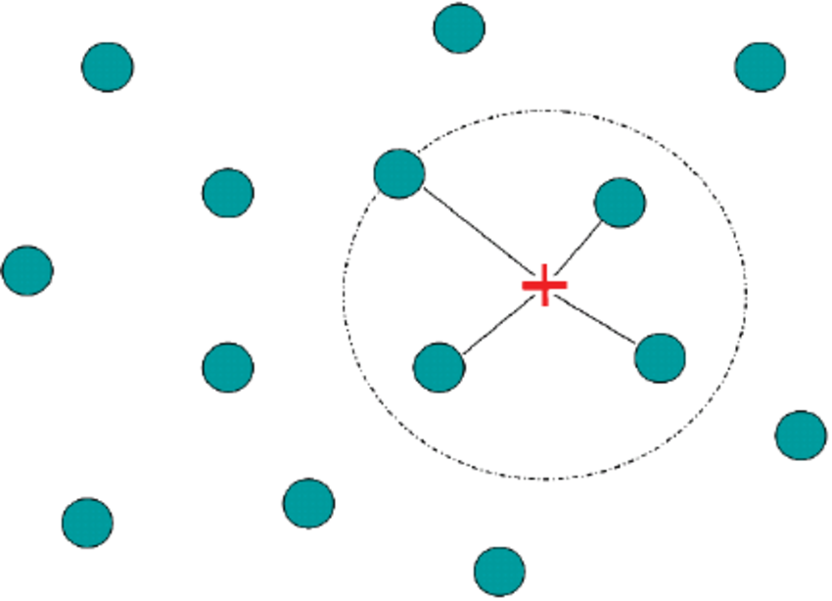
Tutoring LLMs for CUDA OpenAI o3-mini
Histogram
Game of Life
K-Nearest Neighbors
Design guidance and abstractions effect on LLM-generated code
Notes:
(…; the three algorithms, what’s challenging, how well the LLM did roughly)
We have performed a study on 3 algorithms from our past work, in which we have a good idea of how an efficient implementation should be designed.
The three algorithms represent implementation problems of increasing complexity.
For the easier, Histogram and Game of Life algorithms, OpenAI o3-mini, a SotA LLM model at that time, generated progressively better code with the increasingly specific prompts.
But for the k-Nearest Neighbors search, it managed to generate valid code only for the naïve prompts.

Slide 68
Tutoring LLMs for CUDA OpenAI o3-mini
Histogram
Game of Life
K-Nearest Neighbors
Privatization in GPU “shared memory”
Bit-lvl vectorization
Inter-thread communication
Design guidance and abstractions effect on LLM-generated code
Notes:
(…; the three algorithms, what’s challenging, how well the LLM did roughly)
We have performed a study on 3 algorithms from our past work, in which we have a good idea of how an efficient implementation should be designed.
The three algorithms represent implementation problems of increasing complexity.
For the easier, Histogram and Game of Life algorithms, OpenAI o3-mini, a SotA LLM model at that time, generated progressively better code with the increasingly specific prompts.
But for the k-Nearest Neighbors search, it managed to generate valid code only for the naïve prompts.

Slide 69
Tutoring LLMs for CUDA OpenAI o3-mini
Histogram
Game of Life
K-Nearest Neighbors
Privatization in GPU “shared memory”
Bit-lvl vectorization
Inter-thread communication
Just implement
✅
🐌
✅
🐌
With hints
✅
🐢
⚠️
🐢
Design direction
✅
🚀
⚠️
🚀
Design guidance and abstractions effect on LLM-generated code
Notes:
(…; the three algorithms, what’s challenging, how well the LLM did roughly)
We have performed a study on 3 algorithms from our past work, in which we have a good idea of how an efficient implementation should be designed.
The three algorithms represent implementation problems of increasing complexity.
For the easier, Histogram and Game of Life algorithms, OpenAI o3-mini, a SotA LLM model at that time, generated progressively better code with the increasingly specific prompts.
But for the k-Nearest Neighbors search, it managed to generate valid code only for the naïve prompts.

Slide 70
Tutoring LLMs for CUDA OpenAI o3-mini
Histogram
Game of Life
K-Nearest Neighbors
Privatization in GPU “shared memory”
Bit-lvl vectorization
Inter-thread communication
Just implement
✅
🐌
✅
🐌
⚠️
🐌
With hints
✅
🐢
⚠️
🐢
❌
Design direction
✅
🚀
⚠️
🚀
❌
Design guidance and abstractions effect on LLM-generated code
Notes:
(…; the three algorithms, what’s challenging, how well the LLM did roughly)
We have performed a study on 3 algorithms from our past work, in which we have a good idea of how an efficient implementation should be designed.
The three algorithms represent implementation problems of increasing complexity.
For the easier, Histogram and Game of Life algorithms, OpenAI o3-mini, a SotA LLM model at that time, generated progressively better code with the increasingly specific prompts.
But for the k-Nearest Neighbors search, it managed to generate valid code only for the naïve prompts.

Slide 71
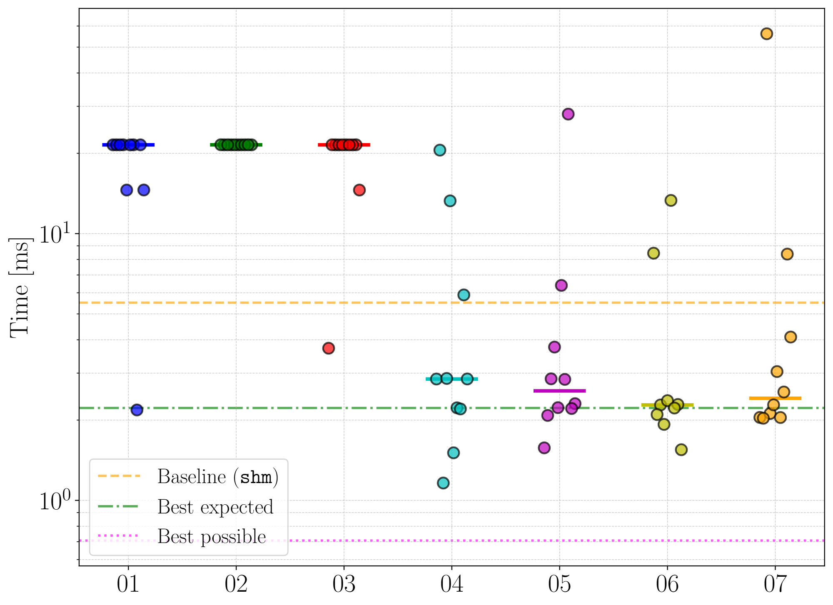
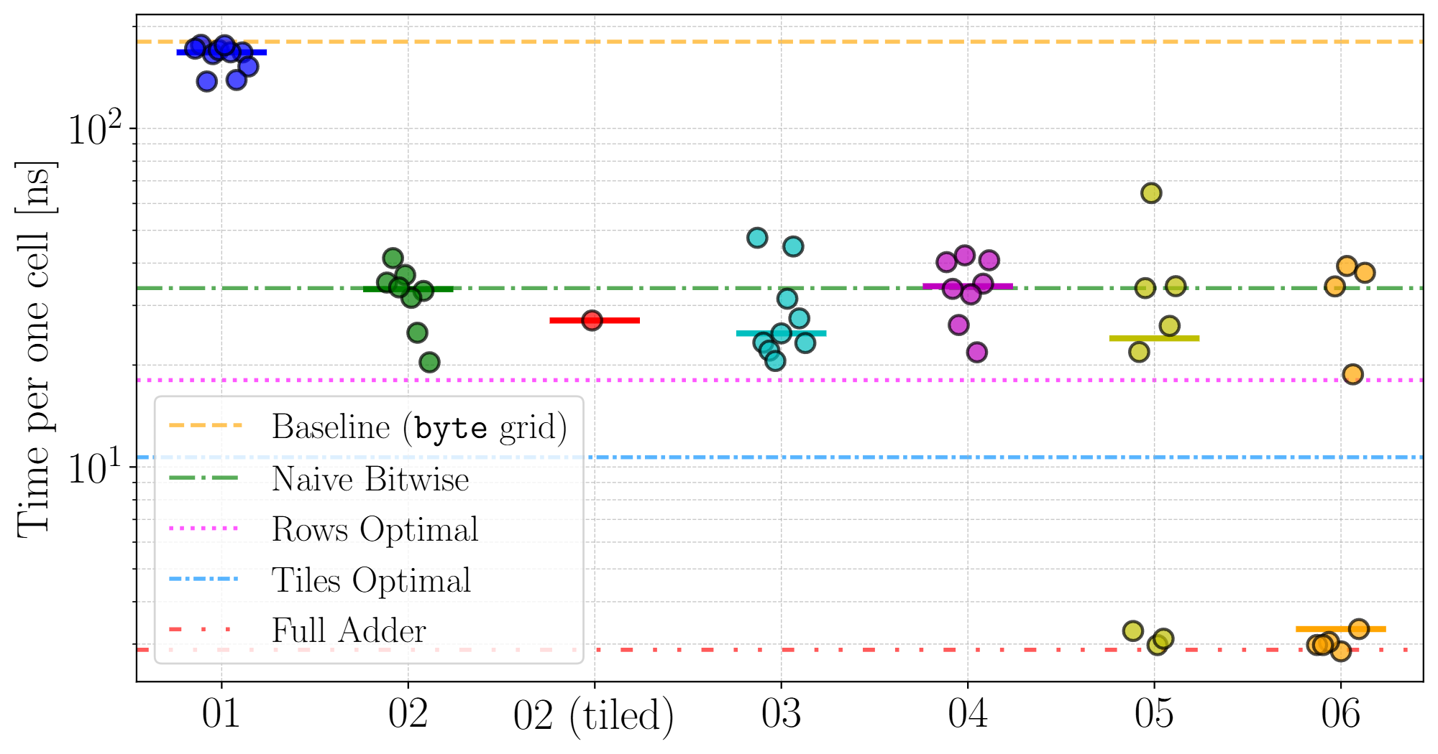
Tutoring LLMs for CUDA – submission OpenAI o3-mini
Histogram
Game of Life
Prompt specificity (naïve → … → design specification)
Prompt specificity (naïve → … → design specification)
Design guidance and abstractions effect on LLM-generated code
Notes:
(key idea: the performance progression matches the assumption)
Here, we can see the plots for the runtime measurements of the generated code for the Histogram and Game of Life algorithms. (lower is better)
The x-axis of both indicates increasingly specific prompts, and the horizontal lines mark various reference implementations.
The performance improves with more specific prompts, which is slightly noticeable for the Histogram algorithm, and more so for the Game of Life algorithm.

Slide 72
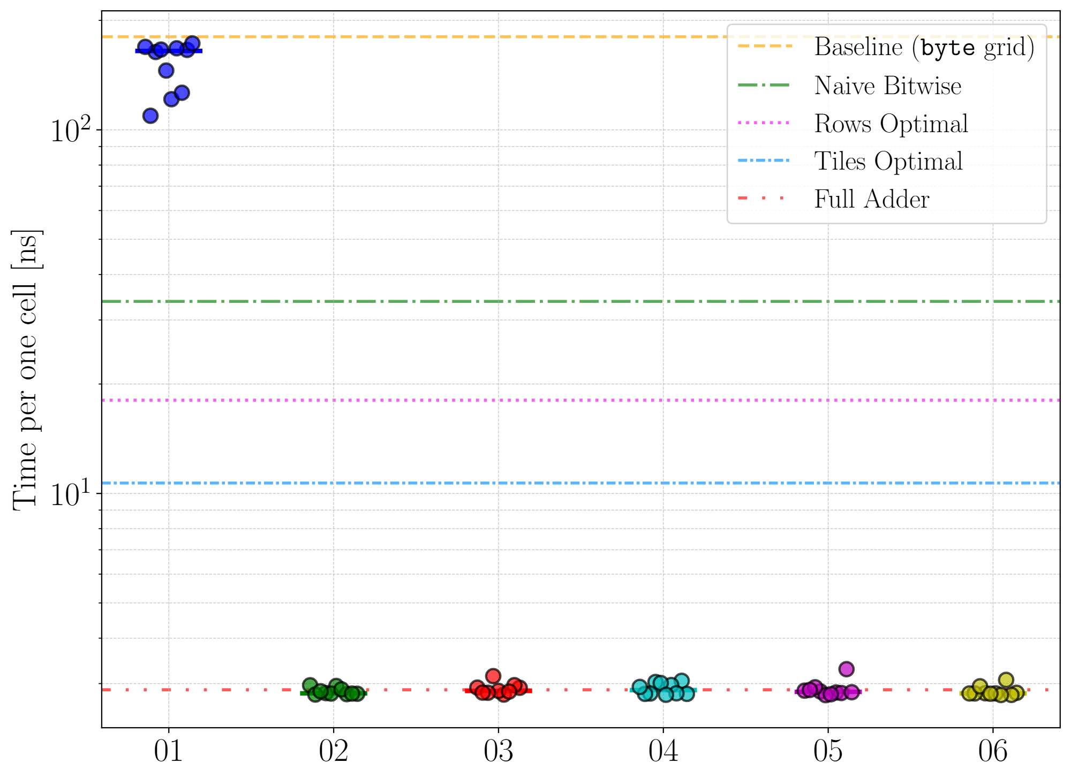
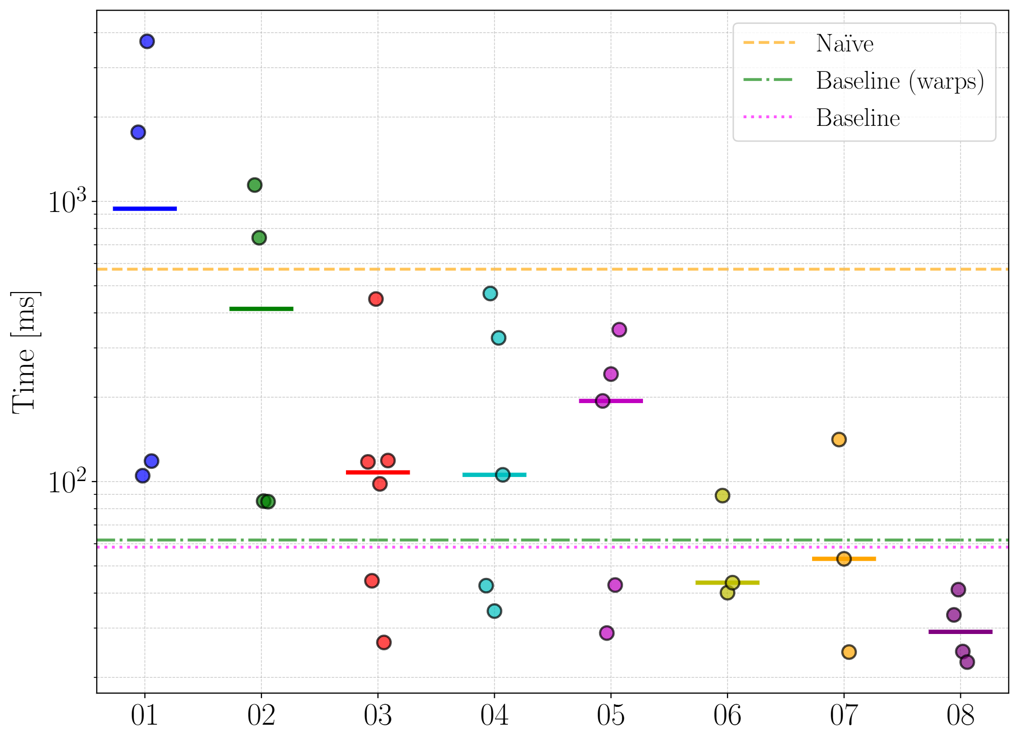
Tutoring LLMs for CUDA – at conference OpenAI GPT-5
Game of Life
k-Nearest Neighbors
Prompt specificity (naïve → … → design specification)
Prompt specificity (naïve → … → design specification)
Design guidance and abstractions effect on LLM-generated code
Notes:
(key idea: LLMs improve over time, the complexity threshold shifts)
When we presented our results at the EuroPar conference, the LLM state of the art had already shifted.
The then-current GPT-5 provided expert-level performance on the Game of Life algorithm for all prompts except the naïve one, and it successfully benefited from tutoring for the k-Nearest Neighbor algorithm.

Slide 73
LLMs and abstractions
Simplifying algorithm design & optimization
Abstractions
LLMs
Design guidance and abstractions effect on LLM-generated code
Notes:
(key idea: combining the two branches)
We have shown that both abstractions and LLMs can be practical solutions for simplifying algorithm design & optimization.
Both have their strengths and weaknesses;
Abstractions may improve interpretability of the code and they are deterministic; however, they require some learning and may not apply well to specific algorithms
LLMs are much more flexible and can significantly improve automation; on the other hand, they are fundamentally stochastic and may produce complex outputs difficult to interpret.
In our next work, we combine the two approaches to get the benefits of both.

Slide 74
LLMs and abstractions
Simplifying algorithm design & optimization
Abstractions
LLMs
Interpretable
Learning curve
Deterministic
Not general
Design guidance and abstractions effect on LLM-generated code
Notes:
(key idea: combining the two branches)
We have shown that both abstractions and LLMs can be practical solutions for simplifying algorithm design & optimization.
Both have their strengths and weaknesses;
Abstractions may improve interpretability of the code and they are deterministic; however, they require some learning and may not apply well to specific algorithms
LLMs are much more flexible and can significantly improve automation; on the other hand, they are fundamentally stochastic and may produce complex outputs difficult to interpret.
In our next work, we combine the two approaches to get the benefits of both.

Slide 75
LLMs and abstractions
Simplifying algorithm design & optimization
Abstractions
LLMs
Interpretable
Learning curve
Flexible
Stochastic
Deterministic
Not general
Automatic
Complex output
Design guidance and abstractions effect on LLM-generated code
Notes:
(key idea: combining the two branches)
We have shown that both abstractions and LLMs can be practical solutions for simplifying algorithm design & optimization.
Both have their strengths and weaknesses;
Abstractions may improve interpretability of the code and they are deterministic; however, they require some learning and may not apply well to specific algorithms
LLMs are much more flexible and can significantly improve automation; on the other hand, they are fundamentally stochastic and may produce complex outputs difficult to interpret.
In our next work, we combine the two approaches to get the benefits of both.

Slide 76
LLMs and abstractions
Simplifying algorithm design & optimization
Abstractions
LLMs
Interpretable
Learning curve
Flexible
Stochastic
Deterministic
Not general
Automatic
Complex output
Would abstractions help LLMs generate better code?
Design guidance and abstractions effect on LLM-generated code
Notes:
(key idea: combining the two branches)
We have shown that both abstractions and LLMs can be practical solutions for simplifying algorithm design & optimization.
Both have their strengths and weaknesses;
Abstractions may improve interpretability of the code and they are deterministic; however, they require some learning and may not apply well to specific algorithms
LLMs are much more flexible and can significantly improve automation; on the other hand, they are fundamentally stochastic and may produce complex outputs difficult to interpret.
In our next work, we combine the two approaches to get the benefits of both.

Slide 77
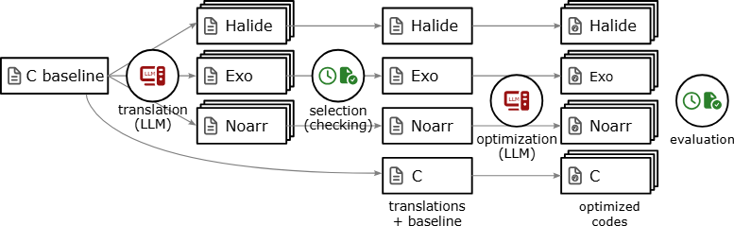
LLMs and abstractions
Design guidance and abstractions effect on LLM-generated code
Notes:
(key idea: we did a lot)
In the experimental setup, the optimization pipeline consisted of two generation steps:
The first translated the baseline algorithm into the given abstraction
And the second one optimized the translation that best matched the baseline
We have applied this workflow to the 30 PolyBench/C algorithms.

Slide 78
LLMs and abstractions
Design guidance and abstractions effect on LLM-generated code
Notes:
(key idea: we did a lot)
In the experimental setup, the optimization pipeline consisted of two generation steps:
The first translated the baseline algorithm into the given abstraction
And the second one optimized the translation that best matched the baseline
We have applied this workflow to the 30 PolyBench/C algorithms.

Slide 79
LLMs and abstractions
PolyBench/C
Design guidance and abstractions effect on LLM-generated code
Notes:
(key idea: we did a lot)
In the experimental setup, the optimization pipeline consisted of two generation steps:
The first translated the baseline algorithm into the given abstraction
And the second one optimized the translation that best matched the baseline
We have applied this workflow to the 30 PolyBench/C algorithms.

Slide 80
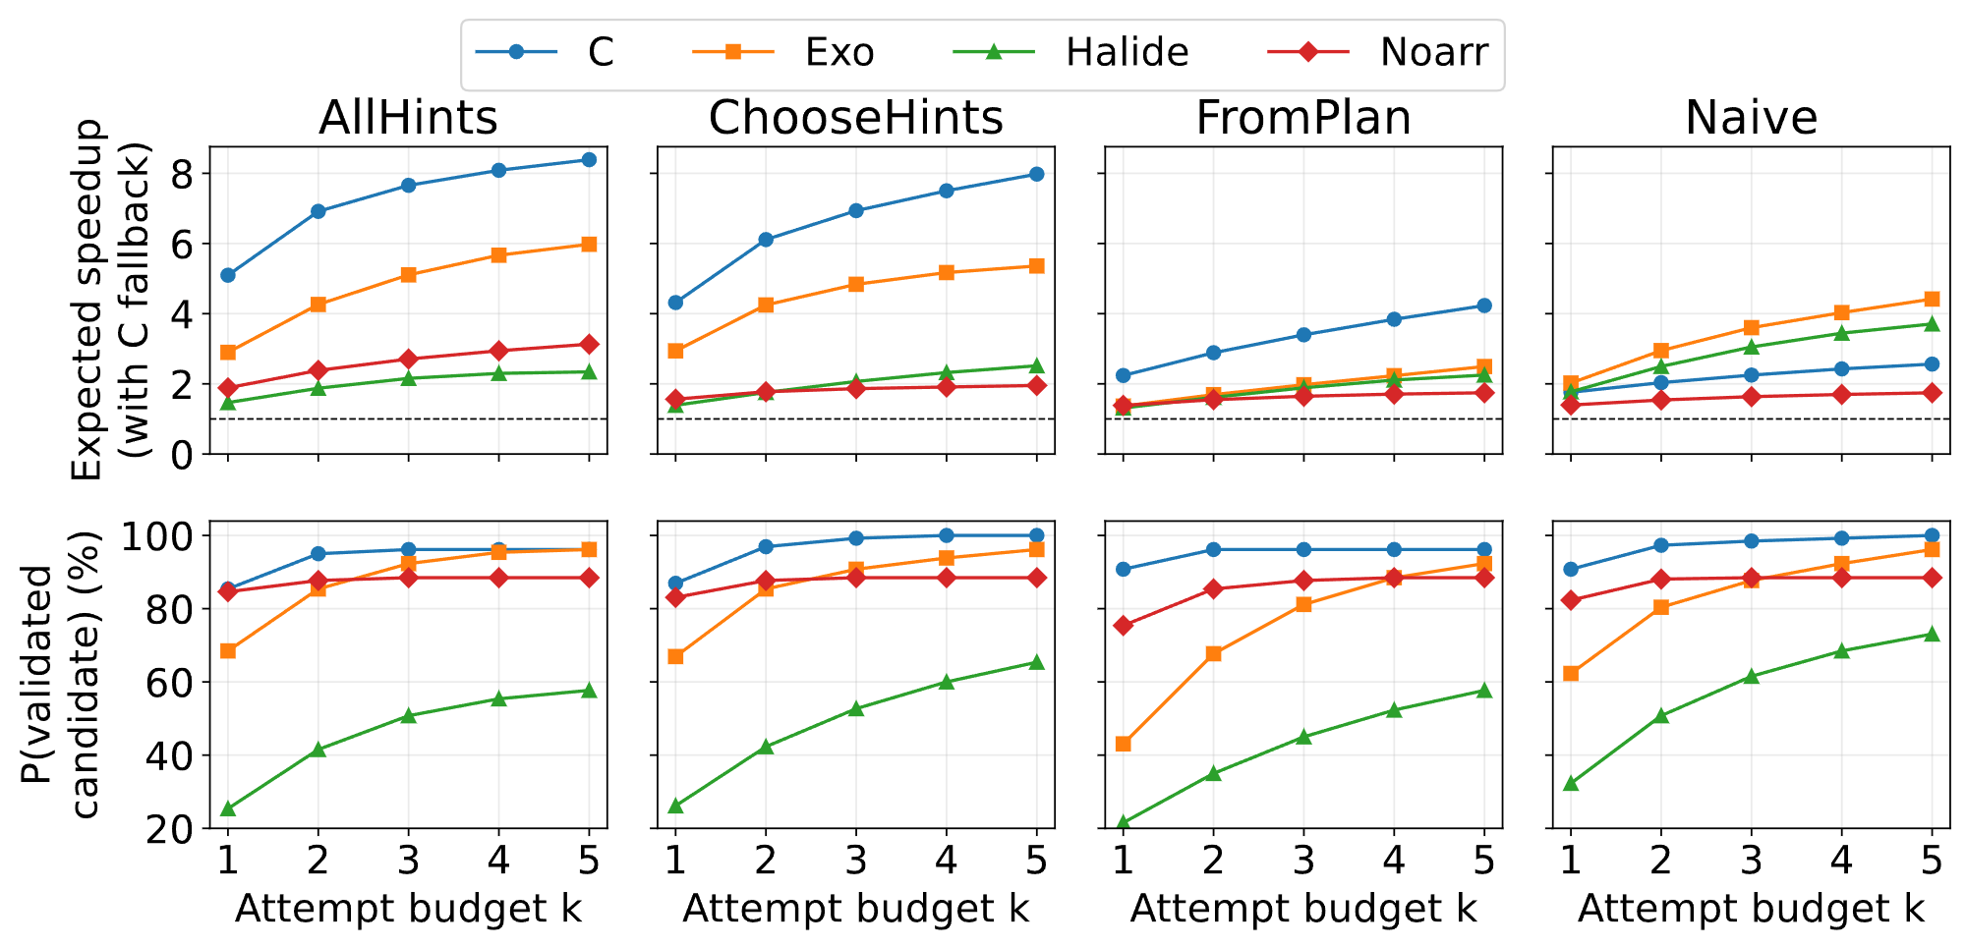
C outperforms the abstractions
Best performance (C)
Design guidance and abstractions effect on LLM-generated code
Notes:
Here, we show the expected speedup and validity for the different abstractions and C. (in both cases, upper is better)
The x-axis shows the number of attempts; more attempts generally lead to a higher chance of finding a successful optimization.
Different columns show different prompting strategies. We observed that the tested abstractions worsened both performance and correctness of the generated code, as generating C code yielded the best performance and correctness overall.
Furthermore, the choice of prompting strategy had a greater effect than the choice of representation.

Slide 81
Answers to research questions
Can developers specify memory access transformations via C++ abstractions without incurring runtime overhead?
Noarr simplifies specifying layouts & traversals, and their transformations
The approach simplifies parallelization and distributed computing
Can developers write abstract computations and choose optimizations of value encoding and evaluation in specific domains?
Cellato enables users to write update rules in an abstract way
Implementation details are applied automatically via prepared components
How do design guidance and abstractions affect the performance and validity of LLM-generated code?
Specific design hints (or directions) improve the quality of LLM-generated code
Abstractions do not significantly improve the performance or the validity

Slide 82
Answers to research questions
Can developers specify memory access transformations via C++ abstractions without incurring runtime overhead?
Noarr simplifies specifying layouts & traversals, and their transformations
The approach simplifies parallelization and distributed computing
Can developers write abstract computations and choose optimizations of value encoding and evaluation in specific domains?
Cellato enables users to write update rules in an abstract way
Implementation details are applied automatically via prepared components
How do design guidance and abstractions affect the performance and validity of LLM-generated code?
Specific design hints (or directions) improve the quality of LLM-generated code
Abstractions do not significantly improve the performance or the validity

Slide 83
Answers to research questions
Can developers specify memory access transformations via C++ abstractions without incurring runtime overhead?
Noarr simplifies specifying layouts & traversals, and their transformations
The approach simplifies parallelization and distributed computing
Can developers write abstract computations and choose optimizations of value encoding and evaluation in specific domains?
Cellato enables users to write update rules in an abstract way
Implementation details are applied automatically via prepared components
How do design guidance and abstractions affect the performance and validity of LLM-generated code?
Specific design hints (or directions) improve the quality of LLM-generated code
Abstractions do not significantly improve the performance or the validity

Slide 84
Review comments and questions

Slide 85
Why is Cellato separate from Noarr?
Optimization tied to bit-level encoding and bitwise evaluation
Noarr doesn’t inspect or abstract statements/expressions
Cellato adopts layout & traversal agnosticism and the template metaprogramming implementation; the goals are more specific

Slide 86
What do you think an abstraction designed specifically for an LLM should look like?
A good answer would require a specific study
I have identified (at the time of experiments) that C++ syntax was quite challenging to the LLM (particularly angle brackets)
Python-based Exo performed best out of the studied abstractions
Good performance on abstraction-less C suggests more explicit representation might perform better
Agentic LLMs might benefit from extensive compiler feedback and runtime metrics
Inspiration by ComPilot: structured back-and-forth communication

Slide 87
Is hvector necessary? vector more convenient?
For a general multidimensional structure, hvector is more convenient
For the first iteration, vector seems like the right choice
For later iterations, the underlying datatype is the previous iteration
Then works conveniently only for contiguous-like encodings
Not for the following: the extent of sub-layout does not divide the stride of the result layout (see Slide 4 for better visualization of the two communicated layouts)
(context: type_vector uses extent of the underlying type for offset calc.)
extent
1.
2.
stride

Slide 88
Is Noarr used outside the department? If not, why?
Some little use
Adam Šmelko (past member of the department)
Marek Čupr (BUT student)
Noarr is mostly an experimental tool
Development tied to research
CuTe?

Slide 89
Can Noarr naturally incorporate #pragma omp simd or SIMD-aware traversers
OpenMP SIMD explicitly rejects class-based iteration (e.g., range-based for)
#pragma omp simd specifically may be in explicit SIMD-enabled for_each
traverser.omp_simd_for_each(…)
More extensive OpenMP pragma support challenging
Future SIMD-aware traversers
Possible with computation-aware abstractions
Noarr already implements “planners” ← traversers that store the computation and enable more expressive transformations

Slide 90
Novelty in layout- and traversal-agnosticism
We do not claim to invent these two concepts as new paradigms
The thesis explicitly studies the two concepts
introducing them as two identified underexplored principles
Main novelty
Unified approach for layout & traversal-agnostic algorithm design
Named dimensions and compositional approach
Abstracting evaluation strategy and encoding for Cellular Automata

Slide 91
Which of these ideas can be found in software like Kokkos or OpenMP's loop transformations?
(reaction to layout- and traversal-agnostic design)
Kokkos Views (and mdspans) abstract physical memory layout
Limited to multidimensional arrays
Mostly focus row-major vs column-major (and custom strides)
Subviews
CuTe supports more general layout algebra
OpenMP (6.0) ← some powerful loop transformation directives
Not exactly traversal-agnostic design; good alternative in many use cases
Notes:
On the other hand, the text suffers from overstated novelty. The text is written in a way that risks giving the impression that the candidate invented the two optimisation paradigms (layout-agnostic and traversal-agnostic design) outright. This is misleading and, notably, does not serve the candidate's own case well: the candidate's contribution here is best characterised as a minor, incremental one within an existing landscape of optimisations. Which of these ideas can also be found in software like Kokkos or OpenMP's loop transformations?
My intention was to introduce the two “paradigms” as explicitly named design directions for improving user-directed optimization of algorithms in HPC. I agree that the wording could have been more careful.
Kokkos views and their related mdspans from the standard C++ library support some level of layout agnosticism; namely, they enable defining general interfaces for multidimensional arrays as well as their (rectangular) sub-arrays, which might be useful, for example, for divide-and-conquer strategies in layout-agnostic algorithms.
This, even by itself, is very useful, and CuTe even provides a particularly powerful layout algebra for tensor computation on GPUs, but does not provide the same unified generalization to traversals, autotuning support, and MPI integration. New standards of OpenMP support powerful loop transformations, which might be used to optimize algorithms. While this doesn’t enable traversal-agnostic design of algorithms, it offers a good alternative with similar benefits in many use cases, especially for algorithms that have a natural loop nest representation that allows for such transformations.
In the thesis (section 2.3.3), we lightly discuss some traversal-agnostic features of GridTools and RAJA.

Slide 92
State of the art summary and our novelty
Layout abstractions
Kokkos Views for general use, GridTools for stencils
Both target CPU & GPU
Both implement facilities for automatic parallelization, tiling (, halo exchange)
Alternative layout and traversal transformation, parallelization
Algorithm + schedule model: Halide, Tiramisu, Exo, OpenMP, …
Tools/frameworks that rely on (custom) compilation pipelines
Policy-based execution model: Kokkos, standard C++ algorithms
Novelty
Native C++ compositional approach with named dimensions (Noarr)
Sub-byte encoding and bitwise evaluation strategies (Cellato)

Slide 93
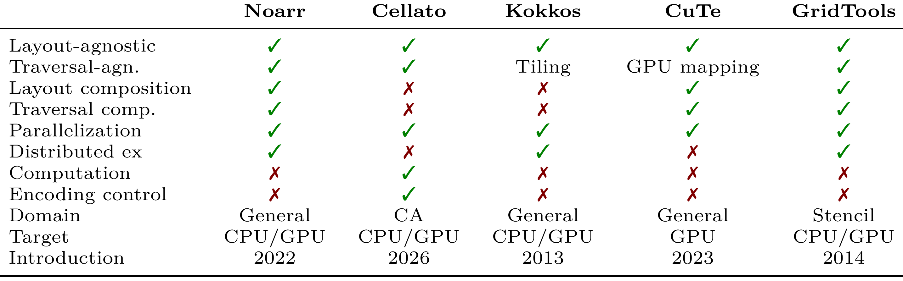
Comparison table

Slide 94
Genuine limitations of Noarr and Cellato
Not paired with formal verification
Compilation time overhead
Template metaprogramming imposes some limitations
The syntax of the resulting DSLs may be awkward
Makes online tuning more costly compared to alternatives such as mdspans or Kokkos Views (recompilation)
Usability not supported by user studies

Slide 95
Template-exclusive statements
I do not claim that templates are the only solution
We do not consider compilation pipeline extensions (e.g., compiler extensions) due to:
Such solutions hindering portability; reliance on external tools
Core research group focus and expertise
Research scope closely tied to algorithm design
Notes:
I currently struggle with interpreting the reviewer’s concern, will return to that.

Slide 96
Why did the abstractions hinder the LLM
Some generated Noarr layouts preserve syntactic order of dimensions rather than the semantic one (unintended layout transformations)
Halide was an awkward representation for many algorithms
Hallucinated API
(mostly for Halide), the LLM considered more general function overloads
(mostly for Exo), the LLM failed to preserve expected invariants
(mostly for Noarr), the LLM made genuine mistakes (e.g., replaced angle brackets with square brackets)

Slide 97
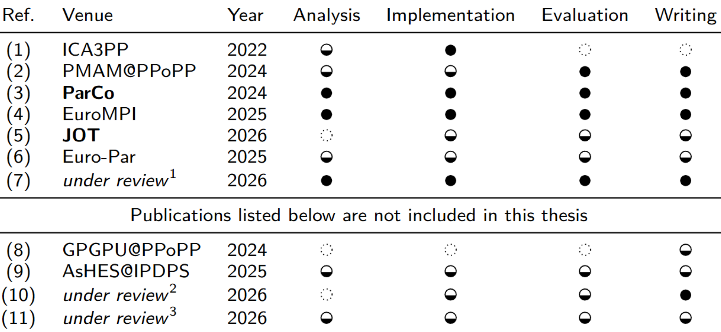
Contribution summary
Layouts
Noarr
Traversals
Autotuning
Distributed
Cellato
CA abstraction
Tutoring LLMs for CUDA
LLMs and abstractions
ICA3PP
GPU EmbedSOM
Bitwise encoding of GoL
kNN with bitonic sort
Bit-Planes – CA abstr.

Slide 98
Contribution map
Stencil computation
General HPC computing
LLM code generation
k-Nearest Neighbors

Slide 99
Contribution map
Stencil computation
General HPC computing
Layouts
LLM code generation
k-Nearest Neighbors

Slide 100
Contribution map
Stencil computation
General HPC computing
Layouts
Traversals
LLM code generation
k-Nearest Neighbors

Slide 101
Contribution map
Stencil computation
General HPC computing
Layouts
Traversals
Autotuning
LLM code generation
k-Nearest Neighbors

Slide 102
Contribution map
Stencil computation
General HPC computing
Layouts
Traversals
Autotuning
kNN with bitonic sort
LLM code generation
k-Nearest Neighbors

Slide 103
Contribution map
Stencil computation
General HPC computing
Layouts
Bitwise encoding of GoL
Traversals
Autotuning
kNN with bitonic sort
LLM code generation
k-Nearest Neighbors

Slide 104
Contribution map
Stencil computation
General HPC computing
Layouts
Bitwise encoding of GoL
Traversals
Autotuning
Tutoring LLMs for CUDA
kNN with bitonic sort
LLM code generation
k-Nearest Neighbors

Slide 105
Contribution map
Stencil computation
General HPC computing
Layouts
Bitwise encoding of GoL
Traversals
Autotuning
Distributed
Tutoring LLMs for CUDA
kNN with bitonic sort
LLM code generation
k-Nearest Neighbors

Slide 106
Contribution map
Stencil computation
General HPC computing
Knowledge transfer
CA abstraction
Layouts
Bitwise encoding of GoL
Traversals
Autotuning
Distributed
Tutoring LLMs for CUDA
kNN with bitonic sort
LLM code generation
k-Nearest Neighbors

Slide 107
Contribution map
Stencil computation
General HPC computing
Knowledge transfer
CA abstraction
Layouts
Bitwise encoding of GoL
Traversals
Autotuning
LLMs and abstractions
Distributed
Tutoring LLMs for CUDA
kNN with bitonic sort
LLM code generation
k-Nearest Neighbors

Slide 108
Contribution map
Stencil computation
General HPC computing
Knowledge transfer
CA abstraction
Layouts
Bitwise encoding of GoL
Traversals
Bit-Planes for CA abstraction
Autotuning
LLMs and abstractions
Distributed
Tutoring LLMs for CUDA
kNN with bitonic sort
LLM code generation
k-Nearest Neighbors

Slide 109
Autotuning
Notes:
(key idea: autotuning made easier & we can switch autotuners)
Even with the transformations and parallelization being easily directable by the user, the exploration takes manual effort.
Thus, we have implemented an autotuning interface for these abstractions.
Typically, when we want to use an autotuning framework to optimize an algorithm, we need to:
Define each parameter in the code
And define the same parameter on the autotuner’s side
The autotuner-provided values may be used in preprocessor directives to choose between different layouts or injected into the code.
This creates an unnecessary amount of boilerplate code that is difficult to maintain and error-prone.
(…)

Slide 110
Autotuning
Choice of layout
Parameters in the application
Tile size for tiling
Notes:
(key idea: autotuning made easier & we can switch autotuners)
Even with the transformations and parallelization being easily directable by the user, the exploration takes manual effort.
Thus, we have implemented an autotuning interface for these abstractions.
Typically, when we want to use an autotuning framework to optimize an algorithm, we need to:
Define each parameter in the code
And define the same parameter on the autotuner’s side
The autotuner-provided values may be used in preprocessor directives to choose between different layouts or injected into the code.
This creates an unnecessary amount of boilerplate code that is difficult to maintain and error-prone.
(…)

Slide 111
Autotuning
Choice of layout
Categorical value
Parameters in the application
Parameters in an autotuner script
Tile size for tiling
Numerical value
Notes:
(key idea: autotuning made easier & we can switch autotuners)
Even with the transformations and parallelization being easily directable by the user, the exploration takes manual effort.
Thus, we have implemented an autotuning interface for these abstractions.
Typically, when we want to use an autotuning framework to optimize an algorithm, we need to:
Define each parameter in the code
And define the same parameter on the autotuner’s side
The autotuner-provided values may be used in preprocessor directives to choose between different layouts or injected into the code.
This creates an unnecessary amount of boilerplate code that is difficult to maintain and error-prone.
(…)

Slide 112
Autotuning
Choice of layout
Categorical value
Parameters in the application
Communication
Parameters in an autotuner script
Tile size for tiling
Numerical value
Notes:
(key idea: autotuning made easier & we can switch autotuners)
Even with the transformations and parallelization being easily directable by the user, the exploration takes manual effort.
Thus, we have implemented an autotuning interface for these abstractions.
Typically, when we want to use an autotuning framework to optimize an algorithm, we need to:
Define each parameter in the code
And define the same parameter on the autotuner’s side
The autotuner-provided values may be used in preprocessor directives to choose between different layouts or injected into the code.
This creates an unnecessary amount of boilerplate code that is difficult to maintain and error-prone.
(…)

Slide 113
Autotuning
Choice of layout
Categorical value
#if CHOICE = = 1
Parameters in the application
Communication
Parameters in an autotuner script
Tile size for tiling
Numerical value
I += TILE_SIZE
Notes:
(key idea: autotuning made easier & we can switch autotuners)
Even with the transformations and parallelization being easily directable by the user, the exploration takes manual effort.
Thus, we have implemented an autotuning interface for these abstractions.
Typically, when we want to use an autotuning framework to optimize an algorithm, we need to:
Define each parameter in the code
And define the same parameter on the autotuner’s side
The autotuner-provided values may be used in preprocessor directives to choose between different layouts or injected into the code.
This creates an unnecessary amount of boilerplate code that is difficult to maintain and error-prone.
(…)

Slide 114
Autotuning
Choice of layout
Categorical value
#if CHOICE = = 1
Parameters in the application
Communication
Parameters in an autotuner script
Tile size for tiling
Numerical value
I += TILE_SIZE
Too much boilerplate, error-prone
Notes:
(key idea: autotuning made easier & we can switch autotuners)
Even with the transformations and parallelization being easily directable by the user, the exploration takes manual effort.
Thus, we have implemented an autotuning interface for these abstractions.
Typically, when we want to use an autotuning framework to optimize an algorithm, we need to:
Define each parameter in the code
And define the same parameter on the autotuner’s side
The autotuner-provided values may be used in preprocessor directives to choose between different layouts or injected into the code.
This creates an unnecessary amount of boilerplate code that is difficult to maintain and error-prone.
(…)

Slide 115
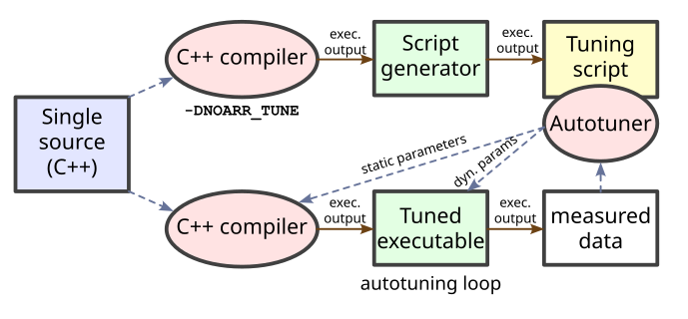
Autotuning
Parameters in the application
Communication
Parameters in an autotuner script
Too much boilerplate, error-prone
Parameters specified once
Used as regular values
Notes:
(key idea: autotuning made easier)
(…)
We have implemented an autotuning interface that allows for specifying the tuned parameters in the same code as the algorithm and using them as regular constants.
This specification is independent of the autotuning backend, and the whole autotuning process is handled automatically, which makes switching between different autotuning frameworks easy.

Slide 116



Autotuning
Parameters in the application
Communication
Parameters in an autotuner script
Too much boilerplate, error-prone
Parameters specified once
Used as regular values
Notes:
(key idea: autotuning made easier)
(…)
We have implemented an autotuning interface that allows for specifying the tuned parameters in the same code as the algorithm and using them as regular constants.
This specification is independent of the autotuning backend, and the whole autotuning process is handled automatically, which makes switching between different autotuning frameworks easy.

Slide 117
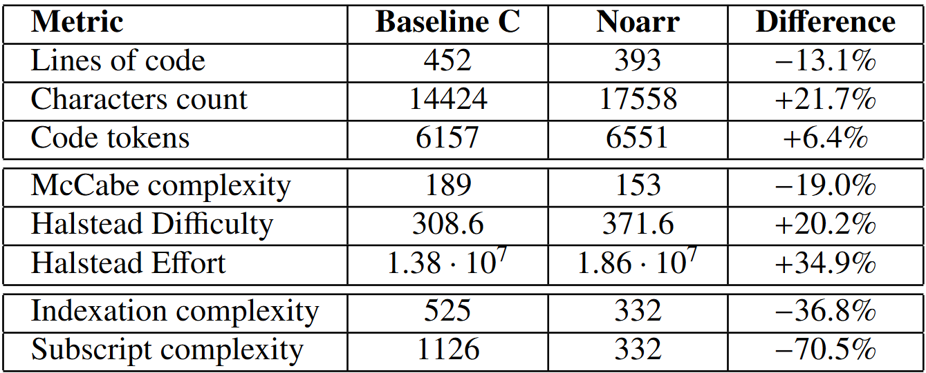
Code metrics
Notes:
(key idea: the abstractions decrease some complexity)
We also evaluated how the abstractions affect code complexity. The code is slightly more verbose (which is not critical due to tools like code completion and static code analyzers), but it also contains less complex control flow (as we can condense complicated traversals into traverser abstractions), and significantly simpler indexation, which can make the code less susceptible to hidden bugs.
On top of these metrics, the algorithm can be optimized without changing its definition by changing the separately defined layouts and traversals. And the approach improves type safety of the expressions by checking that the dimensions are paired correctly.

Slide 118
Code metrics
Slightly more verbose
Notes:
(key idea: the abstractions decrease some complexity)
We also evaluated how the abstractions affect code complexity. The code is slightly more verbose (which is not critical due to tools like code completion and static code analyzers), but it also contains less complex control flow (as we can condense complicated traversals into traverser abstractions), and significantly simpler indexation, which can make the code less susceptible to hidden bugs.
On top of these metrics, the algorithm can be optimized without changing its definition by changing the separately defined layouts and traversals. And the approach improves type safety of the expressions by checking that the dimensions are paired correctly.

Slide 119
Code metrics
Slightly more verbose
Less complex control flow
Notes:
(key idea: the abstractions decrease some complexity)
We also evaluated how the abstractions affect code complexity. The code is slightly more verbose (which is not critical due to tools like code completion and static code analyzers), but it also contains less complex control flow (as we can condense complicated traversals into traverser abstractions), and significantly simpler indexation, which can make the code less susceptible to hidden bugs.
On top of these metrics, the algorithm can be optimized without changing its definition by changing the separately defined layouts and traversals. And the approach improves type safety of the expressions by checking that the dimensions are paired correctly.

Slide 120
Code metrics
Slightly more verbose
Less complex control flow
Easier indexation
Notes:
(key idea: the abstractions decrease some complexity)
We also evaluated how the abstractions affect code complexity. The code is slightly more verbose (which is not critical due to tools like code completion and static code analyzers), but it also contains less complex control flow (as we can condense complicated traversals into traverser abstractions), and significantly simpler indexation, which can make the code less susceptible to hidden bugs.
On top of these metrics, the algorithm can be optimized without changing its definition by changing the separately defined layouts and traversals. And the approach improves type safety of the expressions by checking that the dimensions are paired correctly.

Slide 121
Code metrics
Slightly more verbose
Less complex control flow
Easier indexation
+ Flexibility
+ Type safety
Notes:
(key idea: the abstractions decrease some complexity)
We also evaluated how the abstractions affect code complexity. The code is slightly more verbose (which is not critical due to tools like code completion and static code analyzers), but it also contains less complex control flow (as we can condense complicated traversals into traverser abstractions), and significantly simpler indexation, which can make the code less susceptible to hidden bugs.
On top of these metrics, the algorithm can be optimized without changing its definition by changing the separately defined layouts and traversals. And the approach improves type safety of the expressions by checking that the dimensions are paired correctly.

Slide 122
LLM-guided optimization summary
Prompting specificity ✅
Contemporary abstractions ❌
Possible future research
Re-evaluate on agentic LLMs
Gather feedback (performance, compile errors, …)
Collect necessary context (e.g., work with an abstraction reference)
More LLM-focused abstractions and scaffolding
LLMs still do not replace abstractions (⬆️flexibility, ⬇️ )
Notes:
In this part of this research, we have shown that prompting specificity improves performance, and further hints can improve output quality if the algorithm is challenging for the LLM,
But requesting the use of contemporary abstractions for user-directed optimization does not help.
Future research may re-evaluate our approach with agentic LLMs that can automatically gather feedback (from compiling and running the generated implementations), and they can also collect the necessary context –
they can, for example, look up how to use specific abstractions or what algorithm designs to use.
It might also be interesting to explore abstraction design with LLMs as their explicit target or enhancing the LLMs with scaffolding that would allow them to keep track of the abstractions and their API.
Our current results do not establish LLMs as a replacement for abstractions, as the studied abstractions are based on deterministic and interpretable transformations, while LLMs offer greater flexibility.

Slide 123
LLM-guided optimization summary
Prompting specificity ✅
Contemporary abstractions ❌
Possible future research
Re-evaluate on agentic LLMs
Gather feedback (performance, compile errors, …)
Collect necessary context (e.g., work with an abstraction reference)
More LLM-focused abstractions and scaffolding
LLMs still do not replace abstractions (⬆️flexibility, ⬇️ )
Notes:
In this part of this research, we have shown that prompting specificity improves performance, and further hints can improve output quality if the algorithm is challenging for the LLM,
But requesting the use of contemporary abstractions for user-directed optimization does not help.
Future research may re-evaluate our approach with agentic LLMs that can automatically gather feedback (from compiling and running the generated implementations), and they can also collect the necessary context –
they can, for example, look up how to use specific abstractions or what algorithm designs to use.
It might also be interesting to explore abstraction design with LLMs as their explicit target or enhancing the LLMs with scaffolding that would allow them to keep track of the abstractions and their API.
Our current results do not establish LLMs as a replacement for abstractions, as the studied abstractions are based on deterministic and interpretable transformations, while LLMs offer greater flexibility.

Slide 124
LLM-guided optimization summary
Prompting specificity ✅
Contemporary abstractions ❌
Possible future research
Re-evaluate on agentic LLMs
Gather feedback (performance, compile errors, …)
Collect necessary context (e.g., work with an abstraction reference)
More LLM-focused abstractions and scaffolding
LLMs still do not replace abstractions (⬆️flexibility, ⬇️ )
Notes:
In this part of this research, we have shown that prompting specificity improves performance, and further hints can improve output quality if the algorithm is challenging for the LLM,
But requesting the use of contemporary abstractions for user-directed optimization does not help.
Future research may re-evaluate our approach with agentic LLMs that can automatically gather feedback (from compiling and running the generated implementations), and they can also collect the necessary context –
they can, for example, look up how to use specific abstractions or what algorithm designs to use.
It might also be interesting to explore abstraction design with LLMs as their explicit target or enhancing the LLMs with scaffolding that would allow them to keep track of the abstractions and their API.
Our current results do not establish LLMs as a replacement for abstractions, as the studied abstractions are based on deterministic and interpretable transformations, while LLMs offer greater flexibility.

Slide 125
LLM-guided optimization summary
Prompting specificity ✅
Contemporary abstractions ❌
Possible future research
Re-evaluate on agentic LLMs
Gather feedback (performance, compile errors, …)
Collect necessary context (e.g., work with an abstraction reference)
More LLM-focused abstractions and scaffolding
LLMs still do not replace abstractions (⬆️flexibility, ⬇️ )
Notes:
In this part of this research, we have shown that prompting specificity improves performance, and further hints can improve output quality if the algorithm is challenging for the LLM,
But requesting the use of contemporary abstractions for user-directed optimization does not help.
Future research may re-evaluate our approach with agentic LLMs that can automatically gather feedback (from compiling and running the generated implementations), and they can also collect the necessary context –
they can, for example, look up how to use specific abstractions or what algorithm designs to use.
It might also be interesting to explore abstraction design with LLMs as their explicit target or enhancing the LLMs with scaffolding that would allow them to keep track of the abstractions and their API.
Our current results do not establish LLMs as a replacement for abstractions, as the studied abstractions are based on deterministic and interpretable transformations, while LLMs offer greater flexibility.

Slide 126
LLM-guided optimization summary
Prompting specificity ✅
Contemporary abstractions ❌
Possible future research
Re-evaluate on agentic LLMs
Gather feedback (performance, compile errors, …)
Collect necessary context (e.g., work with an abstraction reference)
More LLM-focused abstractions and scaffolding
LLMs still do not replace abstractions (⬆️flexibility, ⬇️ )
Notes:
In this part of this research, we have shown that prompting specificity improves performance, and further hints can improve output quality if the algorithm is challenging for the LLM,
But requesting the use of contemporary abstractions for user-directed optimization does not help.
Future research may re-evaluate our approach with agentic LLMs that can automatically gather feedback (from compiling and running the generated implementations), and they can also collect the necessary context –
they can, for example, look up how to use specific abstractions or what algorithm designs to use.
It might also be interesting to explore abstraction design with LLMs as their explicit target or enhancing the LLMs with scaffolding that would allow them to keep track of the abstractions and their API.
Our current results do not establish LLMs as a replacement for abstractions, as the studied abstractions are based on deterministic and interpretable transformations, while LLMs offer greater flexibility.

Slide 127
LLM-guided optimization summary
Prompting specificity ✅
Contemporary abstractions ❌
Possible future research
Re-evaluate on agentic LLMs
Gather feedback (performance, compile errors, …)
Collect necessary context (e.g., work with an abstraction reference)
More LLM-focused abstractions and scaffolding
LLMs still do not replace abstractions (⬆️flexibility, ⬇️ )
Notes:
In this part of this research, we have shown that prompting specificity improves performance, and further hints can improve output quality if the algorithm is challenging for the LLM,
But requesting the use of contemporary abstractions for user-directed optimization does not help.
Future research may re-evaluate our approach with agentic LLMs that can automatically gather feedback (from compiling and running the generated implementations), and they can also collect the necessary context –
they can, for example, look up how to use specific abstractions or what algorithm designs to use.
It might also be interesting to explore abstraction design with LLMs as their explicit target or enhancing the LLMs with scaffolding that would allow them to keep track of the abstractions and their API.
Our current results do not establish LLMs as a replacement for abstractions, as the studied abstractions are based on deterministic and interpretable transformations, while LLMs offer greater flexibility.

Slide 128
LLM-guided optimization summary
Prompting specificity ✅
Contemporary abstractions ❌
Possible future research
Re-evaluate on agentic LLMs
Gather feedback (performance, compile errors, …)
Collect necessary context (e.g., work with an abstraction reference)
More LLM-focused abstractions and scaffolding
LLMs still do not replace abstractions (⬆️flexibility, ⬇️ )
determinism
interpretability
Notes:
In this part of this research, we have shown that prompting specificity improves performance, and further hints can improve output quality if the algorithm is challenging for the LLM,
But requesting the use of contemporary abstractions for user-directed optimization does not help.
Future research may re-evaluate our approach with agentic LLMs that can automatically gather feedback (from compiling and running the generated implementations), and they can also collect the necessary context –
they can, for example, look up how to use specific abstractions or what algorithm designs to use.
It might also be interesting to explore abstraction design with LLMs as their explicit target or enhancing the LLMs with scaffolding that would allow them to keep track of the abstractions and their API.
Our current results do not establish LLMs as a replacement for abstractions, as the studied abstractions are based on deterministic and interpretable transformations, while LLMs offer greater flexibility.

